Slide 1
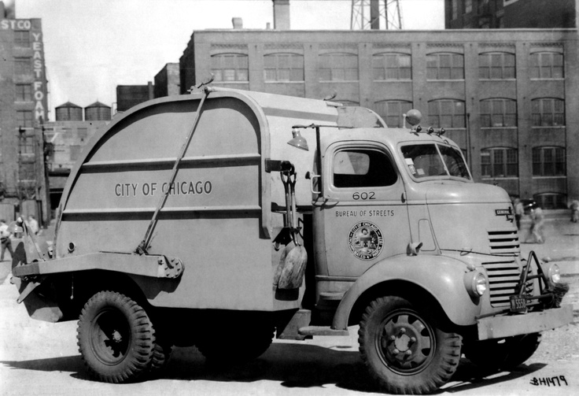
Fast Conservative Garbage Collection
Rifat Shahriyar
Stephen M. Blackburn
Australian National University
Kathryn S. McKinley
Microsoft Research
Notes:
Many of you know and love the BDW conservative collector.
Now it is used in lot of different languages but it was originally designed for C.
Definitely BDW is a very good foundation.
Does that foundation is the best we can do for todays languages?

Slide 2
GC is Ubiquitous
GC implementations
Exact
Conservative
High performance systems use exact GC
Conservative GC is popular
heap
roots
heap
heap
roots
roots
exact
conservative
Notes:
GC – needs to find all live/dead objects
Start from the roots
Roots - all references into the heap held by runtime including stacks, registers, statics, and JNI
Conservative GC is generally used in less performant systems

Slide 3
Performance
16% slowdown a show-stopper in many situations

Slide 4
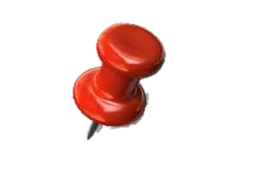
Root Conservative GC
heap
int
roots
Notes:
We are interested in root conservative GC
Where
References in the roots are not precisely known
But references in the heap objects are precisely known

Slide 5
Ambiguous References
May be pointers
Retain referents, transitively
Excess retention
May be values
Cannot change values
Pin referents
May corrupt heap
Validate before updating per-object metadata

Slide 6
Why Conservative GC
Advantages
Disentangles GC from compiler
Avoids challenging engineering of stack maps
Enables more compiler optimizations
Disadvantages
Must handle ambiguous references
Performance
Our goal is high performance conservative GC for managed languages
Notes:
Next – Exact GC

Slide 7
High Performance Exact Garbage Collectors

Slide 8
Immix [Blackburn & McKinley 2008]
object mark
recyclable lines
line mark
block
0
line
line
line
line
Contiguous allocation into regions
256B lines and 32KB blocks
Objects span lines but not blocks
Simple mark phase
Mark objects and containing regions
Free unmarked regions
Recycled allocation and defragmentation

Slide 9
RC Immix [Shahriyar et al. 2013]
1
0
1
3
2
1
0
2
2
0
1
3
0
1
2
Combines RC and Immix
Object local collection
Great mutator locality
Exploit Immix’s opportunistic copy
New objects can be copied by first GC
Old objects can be copied by backup GC
Copying with RC to eliminate fragmentation
Notes:
Next – Conservative GC

Slide 10
Conservative Garbage Collectors

Slide 11
Non-Moving Free list
heap
Designed for fully conservative settings
Problems
Poor performance
Overly conservative design for many settings
roots
Notes:
BDW widely used (Free-list allocator, Mark-sweep collector)
References must point to the start of a valid, live and allocated cell
Those information is already there in the free-list meta data

Slide 12
Mostly-Copying Semi Space
heap
a.k.a. Bartlett-style, with many variants
Problems
Semi-space suffers from huge collection cost
Poor performance
roots
Notes:
Variation over the classical semi-space collector
from/to are not contiguous but linked lists of discontiguous pages
Whole page is pinned and logically promoted

Slide 13
Cost of Conservatism averaged over 20 Java benchmarks
Roots
All exact | 217
Unique exact | 98 | 0.45x
All cons. | 461 | 2.12x
Unique cons. | 157 | 1.6x
Excess retention
 | 44 KB | 0.02%
Pinning
Actual pinned | 14 KB | 0.05%
MCC pinned | 462 KB | 2.1%
MCC false pinned | 282 KB
Immix pinned | 36 KB | 0.2%
The direct cost of conservatism is very low
Notes:
How many false roots are there?
How much extra objects are kept alive?
How much objects cannot move?
We did both conservative and exact side by side
For analysis only not for performance

Slide 14
Heap Organization is Key

Slide 15
Outline
Real source of performance overhead is not conservatism but heap organization
Design and implementation of
Conservative Immix collectors
Conservative reference counting
Evaluation
Notes:
Next - Design

Slide 16
Design
Notes:
How we handle filtering and pinning?

Slide 17
Filtering
heap
Object map filters ambiguous references
Bitmap records locations of all live objects
Allocator sets bit encoding object start address
Collector clears bit for dead objects
roots
Notes:
How to update object map for reference counting and tracing
Software instruction vs. BTS/BTR
Given an object address, find the base address, find the offset, read the word in the object map which is shared, and then use mask to set a bit
BTS/BTR directly set a bit given a base address, 0.6% improvement
Half resolution (1 bit for 4 bytes to 1 bit for 8 bytes)
Because of object alignment requirements and because the VM uses a specific format for its two word header,
the VM can always disambiguate a ‘status word’ and \(TIB) pointer, the two words in every object’s header.
When validating ambiguous pointers, we first determine whether the ambiguous reference points to a valid double word and
then examine those words to determine whether the reference points to the start of an object.

Slide 18
Cost of Filtering
Heap organization trumps object map overhead (2.7%)

Slide 19
Pinning
heap
Immix line pinning, opportunistic copying
Pin referents of ambiguous references
Logically pinned lines cannot be reused
Move other objects as space permits
roots
Notes:
Next - Results

Slide 20
Results

Slide 21
Methodology
20 benchmarks
DaCapo, SPECjvm98 and pjbb2005
20 invocations for each benchmark
Jikes RVM and MMTk
All garbage collectors are parallel
Intel Core i7 4770, 8GB
Ubuntu 12.04.3 LTS
Notes:
Details in paper

Slide 22
Cost of Conservatism normalized to exact
cons
cons
cons
cons
Low performance penalty for conservative collectors

Slide 23
Total Time
cons
RC Immix_{cons} matches Gen Immix and RC Immix

Slide 24
Total Time v Heap Size
cons
RC Immix_{cons} matches Gen Immix and RC Immix
Notes:
Next – Wider applicability

Slide 25
Wider Applicability
Notes:
This is for Java
But we tried to explore how it can be used in the implementation of other language as well

Slide 26
Conservatism and Pinning Amenability of existing systems to conservative RC Immix
Quantify ambiguous references in target applications
Conservative RC Immix tolerates 8x pinning increase with only 3.4% overhead
Modify heap organization to use lines and blocks
Implement full-heap tracing Immix collector (5% improvement)
Depends on code quality
Notes:
Code quality (mature VM or not)

Slide 27
Summary
Conservative GC
Dominated by BDW and MCC
Significant overheads
Heap org. key to performance
New designs
Low overhead object map
Immix line based pinning
Conservative RC Immix
Matches fastest production
Questions?
Available at: https://jira.codehaus.org/browse/RVM-1085

