Slide 1
Chapter 4
The Processor

Slide 2
Introduction
§4.1 Introduction
CPU performance factors
Instruction count
Determined by ISA and compiler
CPI and Cycle time
Determined by CPU hardware
We will examine two MIPS implementations
A simplified version
A more realistic pipelined version
Simple subset, shows most aspects
Memory reference: lw, sw
Arithmetic/logical: add, sub, and, or, slt
Control transfer: beq, j

Slide 3
Instruction Execution
PC → instruction memory, fetch instruction
Register numbers → register file, read registers
Depending on instruction class
Use ALU to calculate
Arithmetic result
Memory address for load/store
Branch target address
Access data memory for load/store
PC ← target address or PC + 4

Slide 4
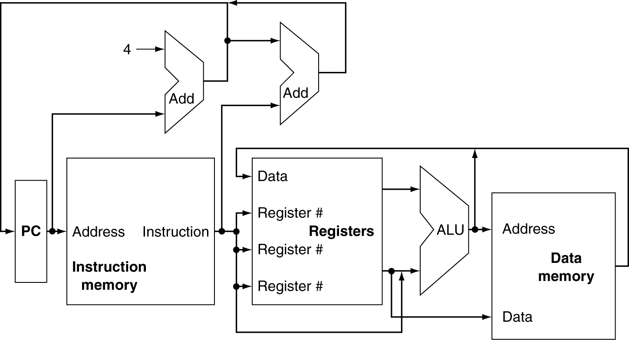
CPU Overview

Slide 5
Multiplexers
Can’t just join wires together
Use multiplexers

Slide 6
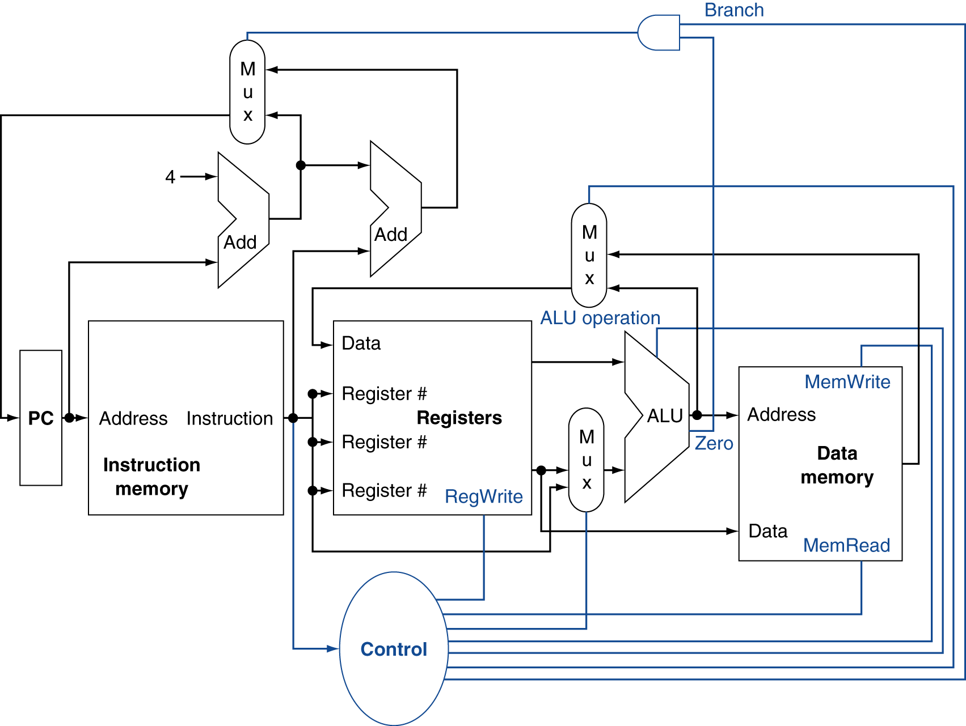
Control

Slide 7
Logic Design Basics
Information encoded in binary
Low voltage = 0, High voltage = 1
One wire per bit
Multi-bit data encoded on multi-wire buses
Combinational element
Operate on data
Output is a function of input
State (sequential) elements
Store information
§4.2 Logic Design Conventions

Slide 8
Combinational Elements
AND-gate
Y = A & B
Adder
Y = A + B
A
+
Y
B
A
Y
B
Arithmetic/Logic Unit
Y = F(A, B)
Multiplexer
Y = S ? I1 : I0
A
I0
M u x
Y
Y
ALU
I1
B
S
F

Slide 9
Sequential Elements
Register: stores data in a circuit
Uses a clock signal to determine when to update the stored value
Edge-triggered: update when Clk changes from 0 to 1
Clk
D
Q
D
Clk
Q

Slide 10
Sequential Elements
Register with write control
Only updates on clock edge when write control input is 1
Used when stored value is required later
Clk
D
Q
Write
Write
D
Clk
Q

Slide 11
Clocking Methodology
Combinational logic transforms data during clock cycles
Between clock edges
Input from state elements, output to state element
Longest delay determines clock period

Slide 12
Building a Datapath
Datapath
Elements that process data and addresses in the CPU
Registers, ALUs, mux’s, memories, …
We will build a MIPS datapath incrementally
Refining the overview design
§4.3 Building a Datapath

Slide 13
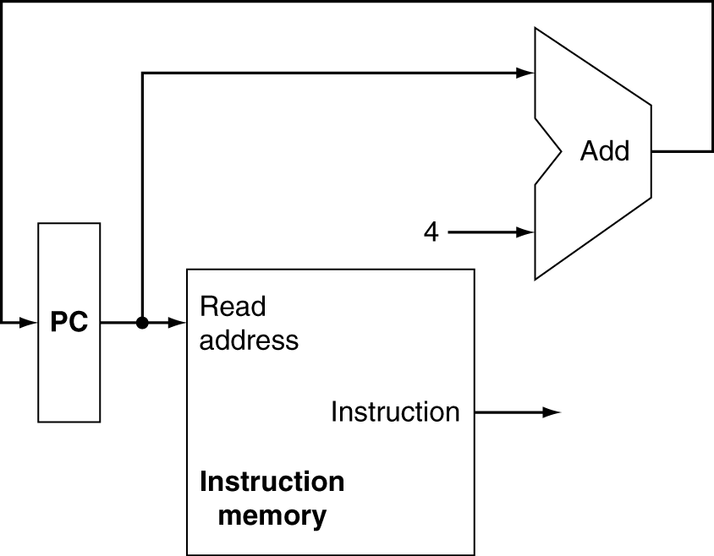
Instruction Fetch
Increment by 4 for next instruction
32-bit register

Slide 14
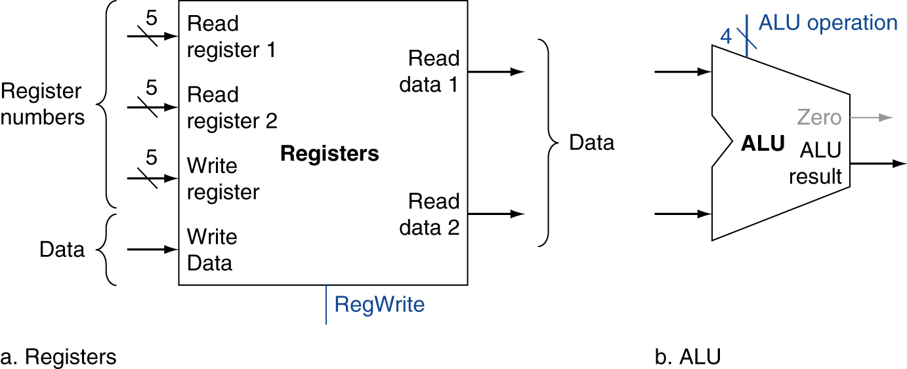
R-Format Instructions
Read two register operands
Perform arithmetic/logical operation
Write register result

Slide 15
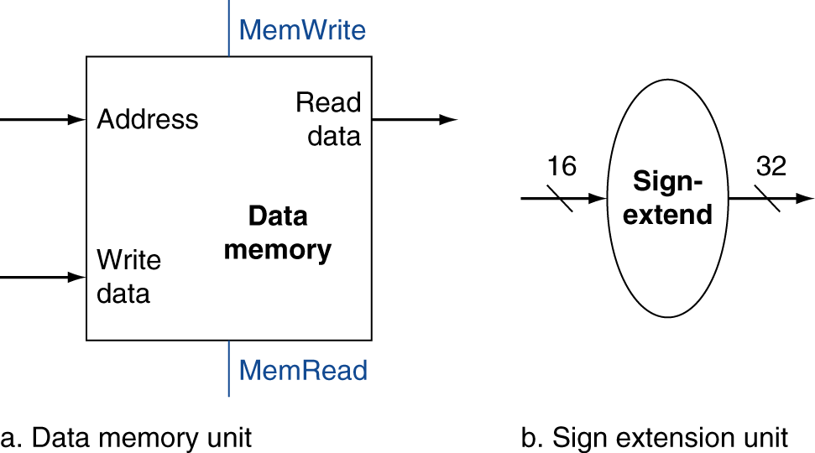
Load/Store Instructions
Read register operands
Calculate address using 16-bit offset
Use ALU, but sign-extend offset
Load: Read memory and update register
Store: Write register value to memory

Slide 16
Branch Instructions
Read register operands
Compare operands
Use ALU, subtract and check Zero output
Calculate target address
Sign-extend displacement
Shift left 2 places (word displacement)
Add to PC + 4
Already calculated by instruction fetch

Slide 17
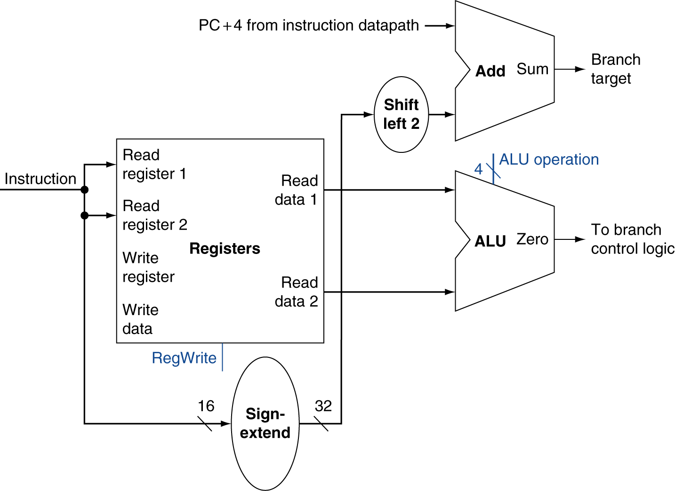
Branch Instructions
Just re-routes wires
Sign-bit wire replicated

Slide 18
Composing the Elements
First-cut data path does an instruction in one clock cycle
Each datapath element can only do one function at a time
Hence, we need separate instruction and data memories
Use multiplexers where alternate data sources are used for different instructions

Slide 19
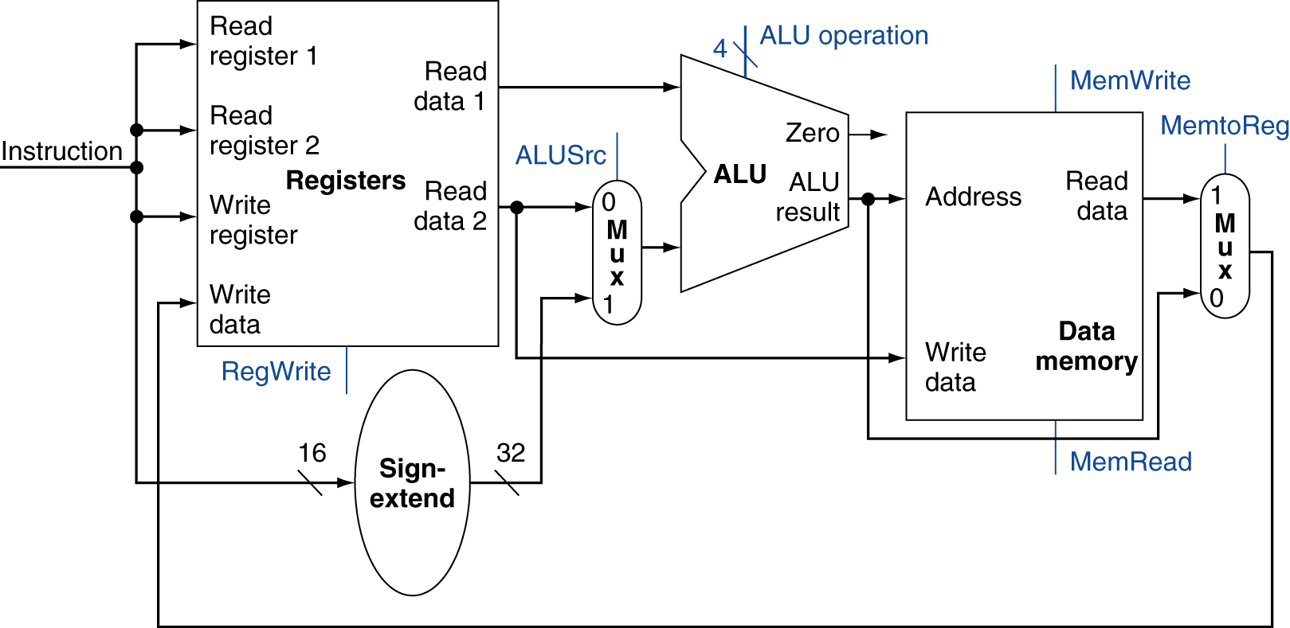
R-Type/Load/Store Datapath

Slide 20
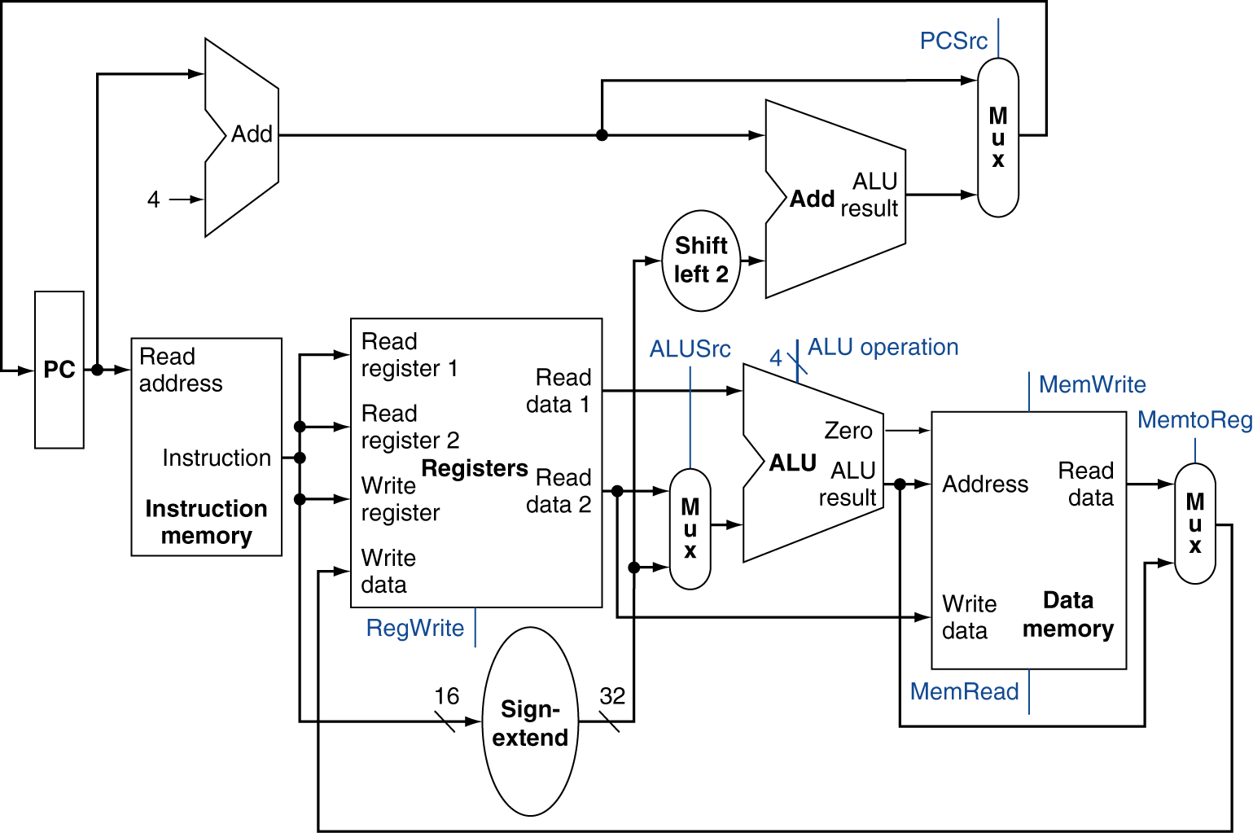
Full Datapath

Slide 21
ALU Control
ALU used for
Load/Store: F = add
Branch: F = subtract
R-type: F depends on funct field
§4.4 A Simple Implementation Scheme
ALU control | Function
0000 | AND
0001 | OR
0010 | add
0110 | subtract
0111 | set-on-less-than
1100 | NOR

Slide 22
ALU Control
Assume 2-bit ALUOp derived from opcode
Combinational logic derives ALU control
opcode | ALUOp | Operation | funct | ALU function | ALU control
lw | 00 | load word | XXXXXX | add | 0010
sw | 00 | store word | XXXXXX | add | 0010
beq | 01 | branch equal | XXXXXX | subtract | 0110
R-type | 10 | add | 100000 | add | 0010
 |  | subtract | 100010 | subtract | 0110
 |  | AND | 100100 | AND | 0000
 |  | OR | 100101 | OR | 0001
 |  | set-on-less-than | 101010 | set-on-less-than | 0111

Slide 23
The Main Control Unit
Control signals derived from instruction
R-type
0
rs
rt
rd
shamt
funct
31:26
25:21
20:16
15:11
10:6
5:0
Load/ Store
35 or 43
rs
rt
address
31:26
25:21
20:16
15:0
Branch
4
rs
rt
address
31:26
25:21
20:16
15:0
opcode
always read
read, except for load
write for R-type and load
sign-extend and add

Slide 24
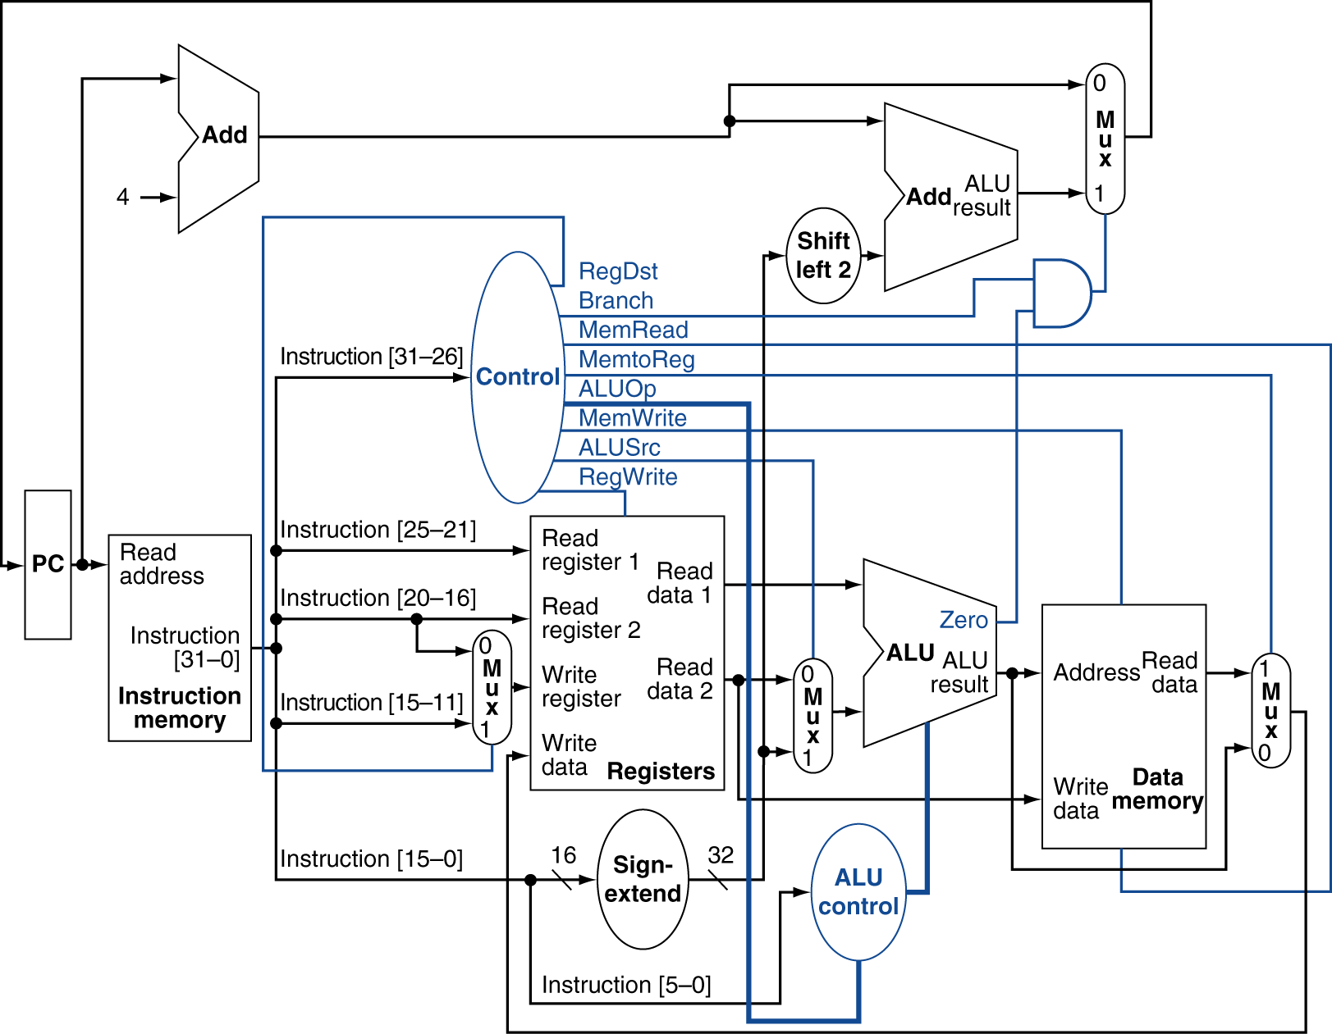
Datapath With Control

Slide 25
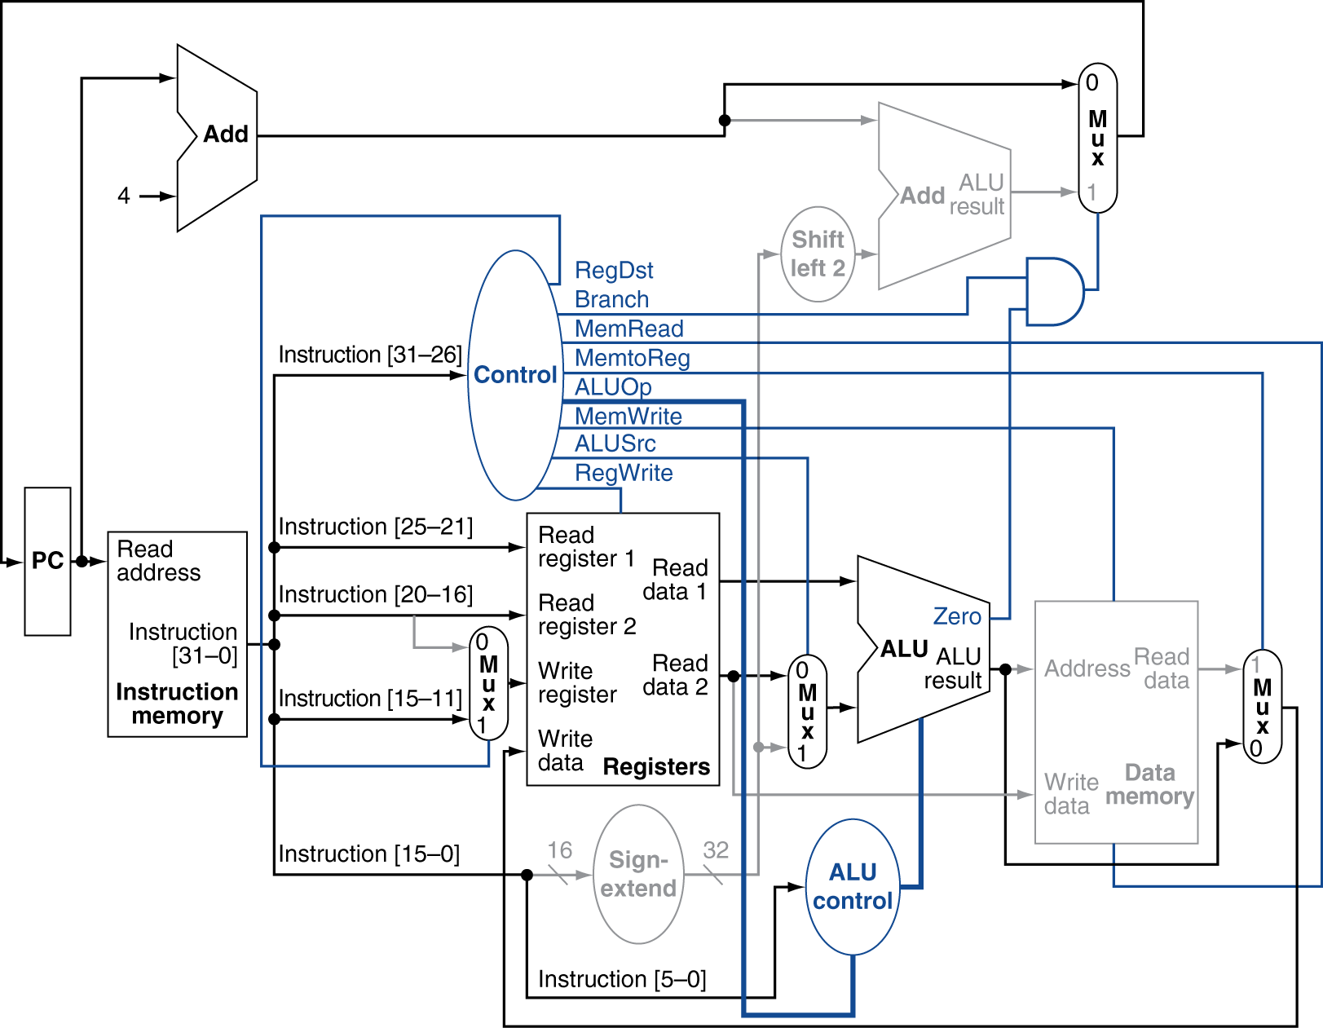
R-Type Instruction

Slide 26
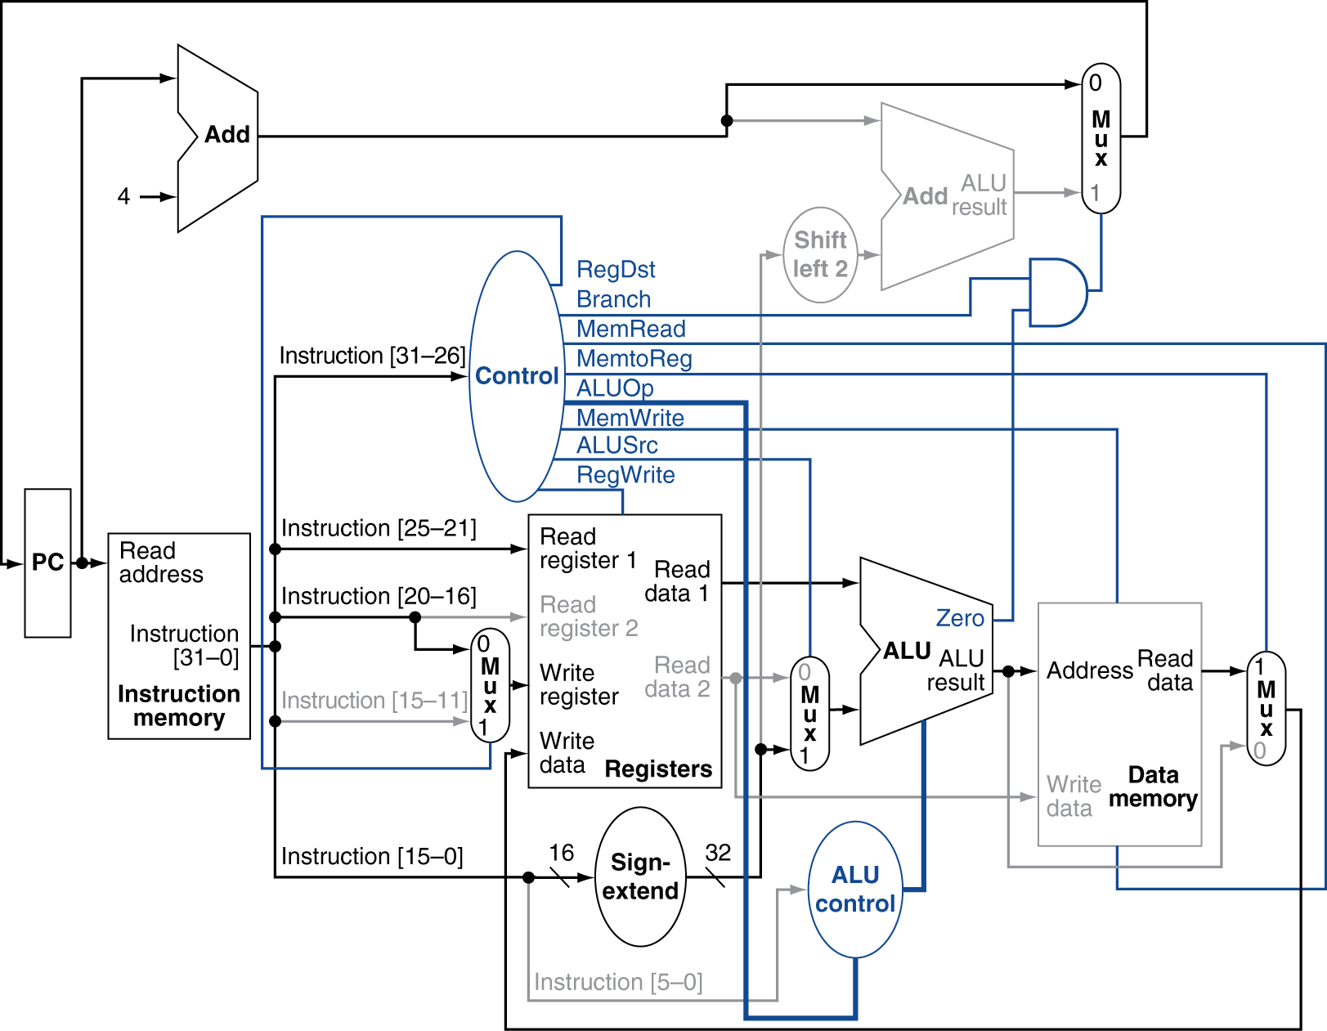
Load Instruction

Slide 27
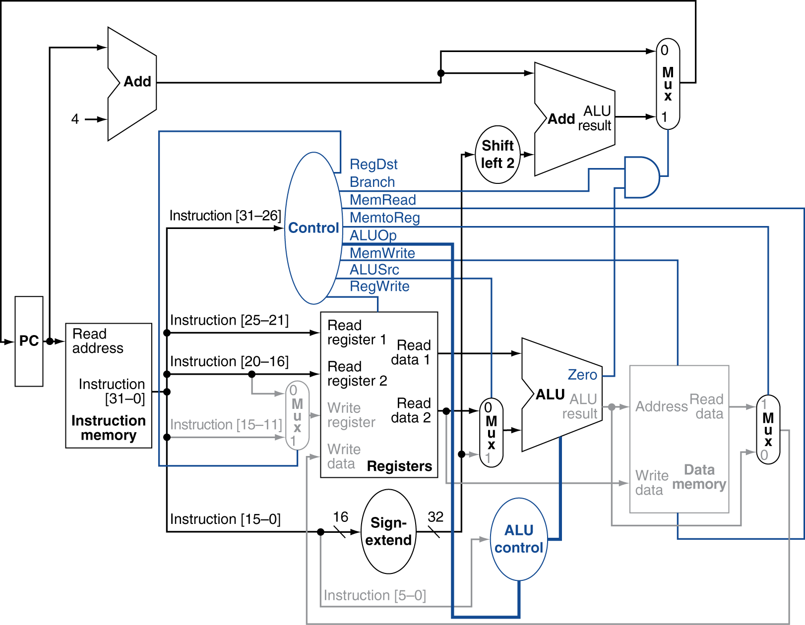
Branch-on-Equal Instruction

Slide 28
Implementing Jumps
Jump
2
address
31:26
25:0
Jump uses word address
Update PC with concatenation of
Top 4 bits of old PC
26-bit jump address
00
Need an extra control signal decoded from opcode

Slide 29
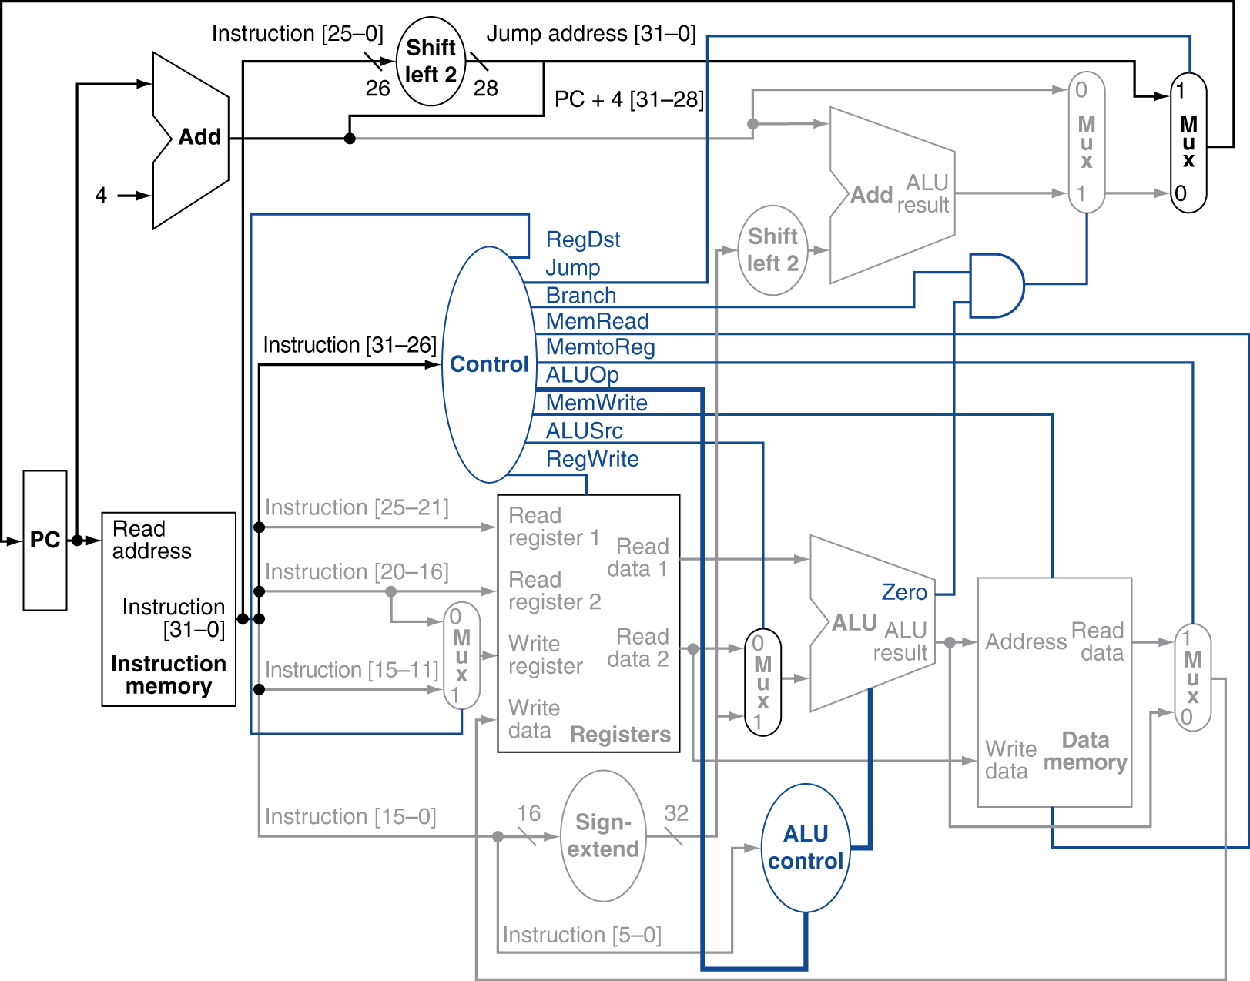
Datapath With Jumps Added

Slide 30
Performance Issues
Longest delay determines clock period
Critical path: load instruction
Instruction memory → register file → ALU → data memory → register file
Not feasible to vary period for different instructions
Violates design principle
Making the common case fast
We will improve performance by pipelining

Slide 31
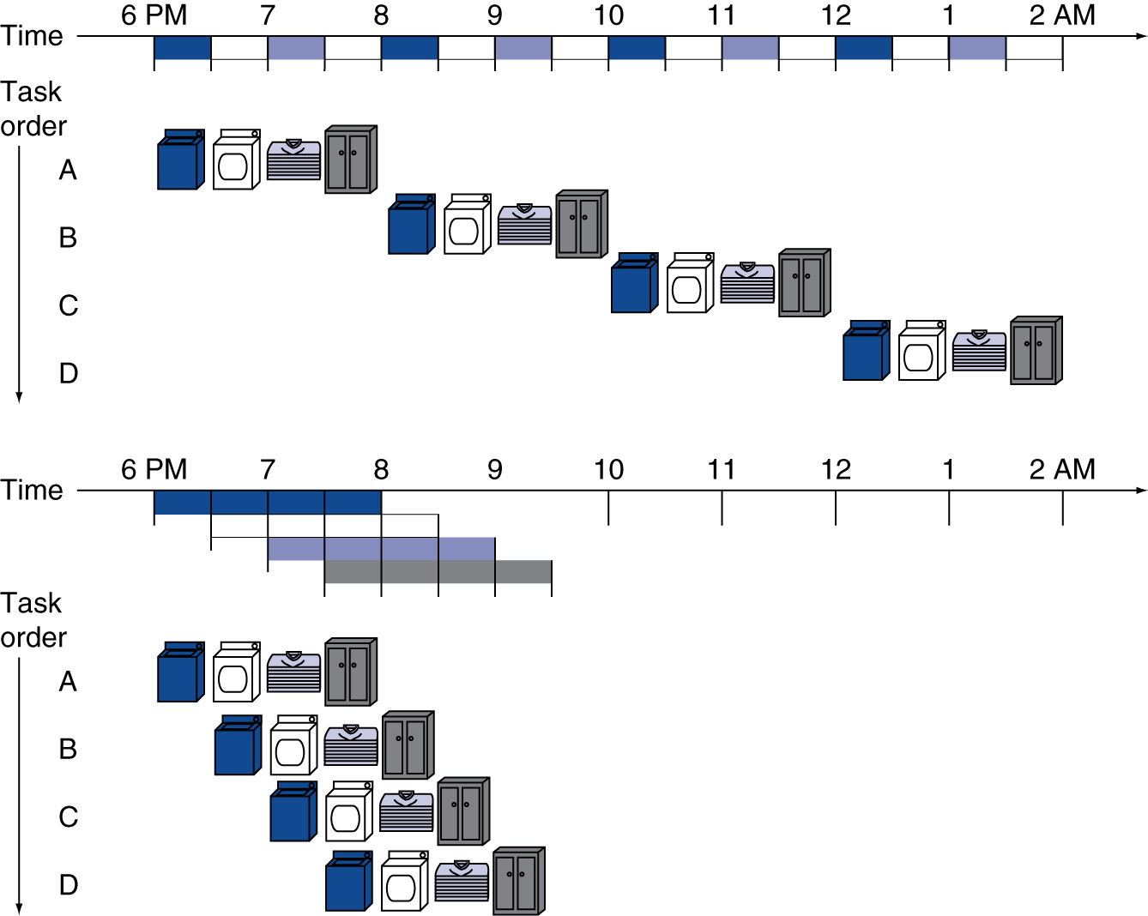
Pipelining Analogy
Pipelined laundry: overlapping execution
Parallelism improves performance
§4.5 An Overview of Pipelining
Four loads:
Speedup = 8/3.5 = 2.3
Non-stop:
Speedup ≈ number of stages

Slide 32
MIPS Pipeline
Five stages, one step per stage
IF: Instruction fetch from memory
ID: Instruction decode & register read
EX: Execute operation or calculate address
MEM: Access memory operand
WB: Write result back to register

Slide 33
Pipeline Performance
Assume time for stages is
100ps for register read or write
200ps for other stages
Compare pipelined datapath with single-cycle datapath
Instr | Instr fetch | Register read | ALU op | Memory access | Register write | Total time
lw | 200ps | 100 ps | 200ps | 200ps | 100 ps | 800ps
sw | 200ps | 100 ps | 200ps | 200ps |  | 700ps
R-format | 200ps | 100 ps | 200ps |  | 100 ps | 600ps
beq | 200ps | 100 ps | 200ps |  |  | 500ps

Slide 34
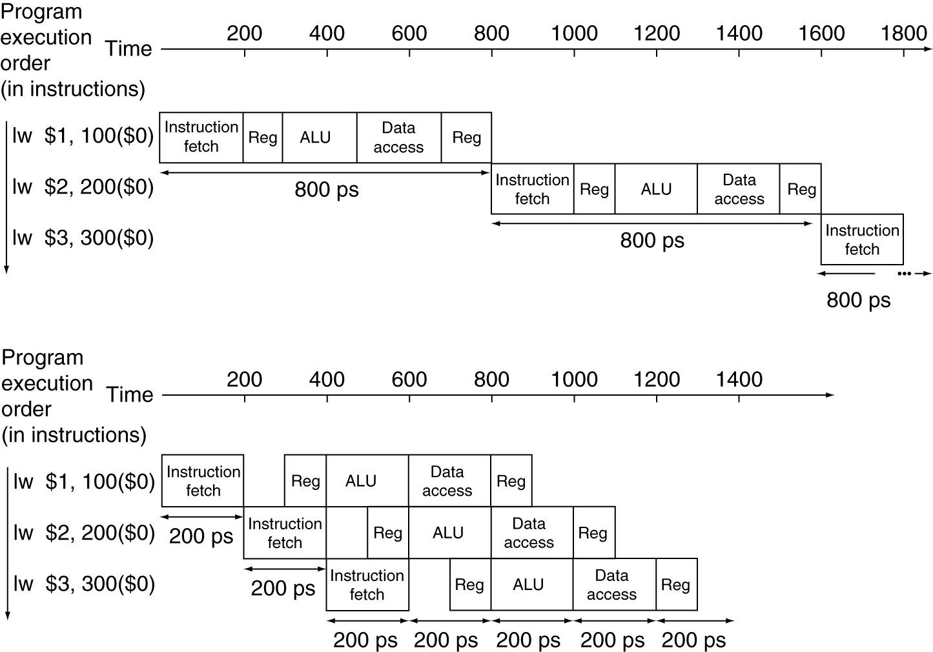
Pipeline Performance
Single-cycle (T_{c}= 800ps)
Pipelined (T_{c}= 200ps)

Slide 35
Pipeline Speedup
If all stages are balanced
i.e., all take the same time
Time between instructions_{pipelined} = Time between instructions_{nonpipelined} Number of stages
In our example, 800/5 = 160ps
If not balanced, speedup is less
Speedup due to increased throughput
Latency (time for each instruction) does not decrease

Slide 36
Pipeline Speedup
Our example with 3 instructions
T_{pipelined} = 1400ps
T_{nopipelined} = 2400ps
Speedup = 2400/1400 = 1.714
Add 1,000,000 instructions
T_{pipelined} = 1,000,000 * 200 + 1400
T_{nopipelined} = 1,000,000 * 800 + 2400
Speedup = 800,002,400/200,001,400 = 4

Slide 37
Pipelining and ISA Design
MIPS ISA designed for pipelining
All instructions are 32-bits
Easier to fetch and decode in one cycle
c.f. x86: 1- to 17-byte instructions
Few and regular instruction formats
Can decode and read registers in one step
Load/store addressing
Can calculate address in 3rd stage, access memory in 4th stage
Alignment of memory operands
Memory access takes only one cycle

Slide 38
Hazards
Situations that prevent starting the next instruction in the next cycle
Structure hazards
A required resource is busy
Data hazard
Need to wait for previous instruction to complete its data read/write
Control hazard
Deciding on control action depends on previous instruction

Slide 39
Structure Hazards
Conflict for use of a resource
In MIPS pipeline with a single memory
Load/store requires data access
Instruction fetch would have to stall for that cycle
Would cause a pipeline “bubble”
Hence, pipelined datapaths require separate instruction/data memories
Or separate instruction/data caches

Slide 40
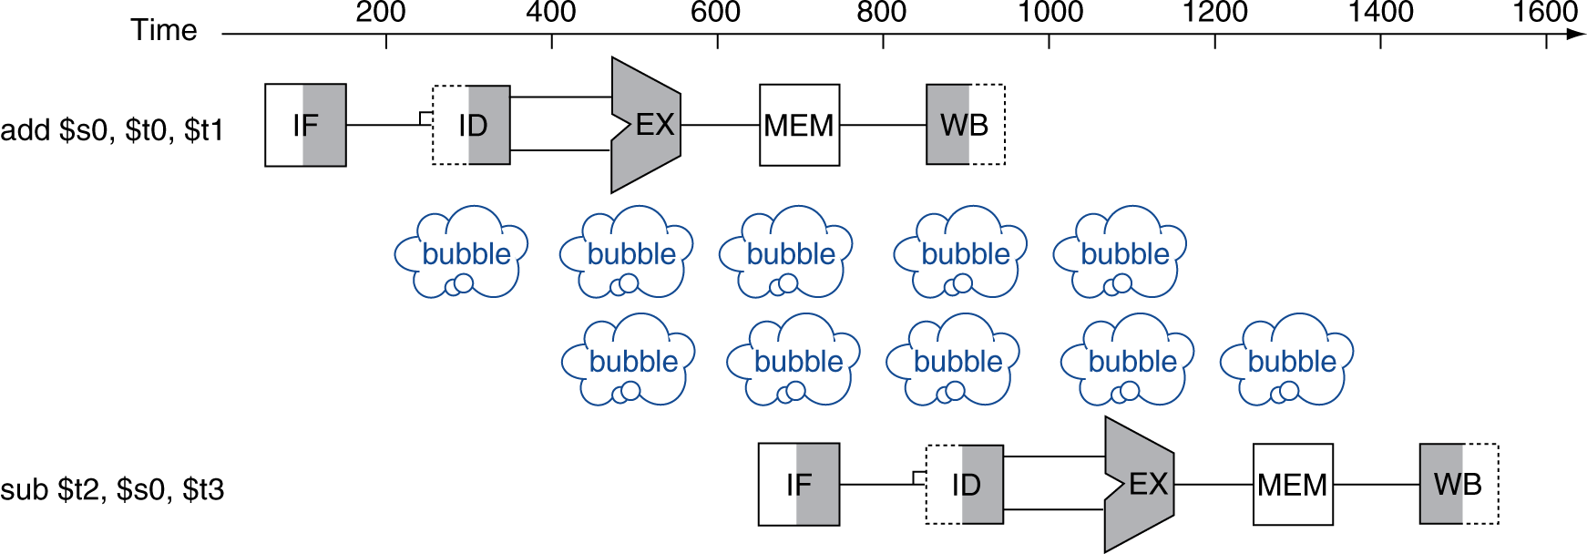
Data Hazards
An instruction depends on completion of data access by a previous instruction
add $s0, $t0, $t1 sub $t2, $s0, $t3

Slide 41
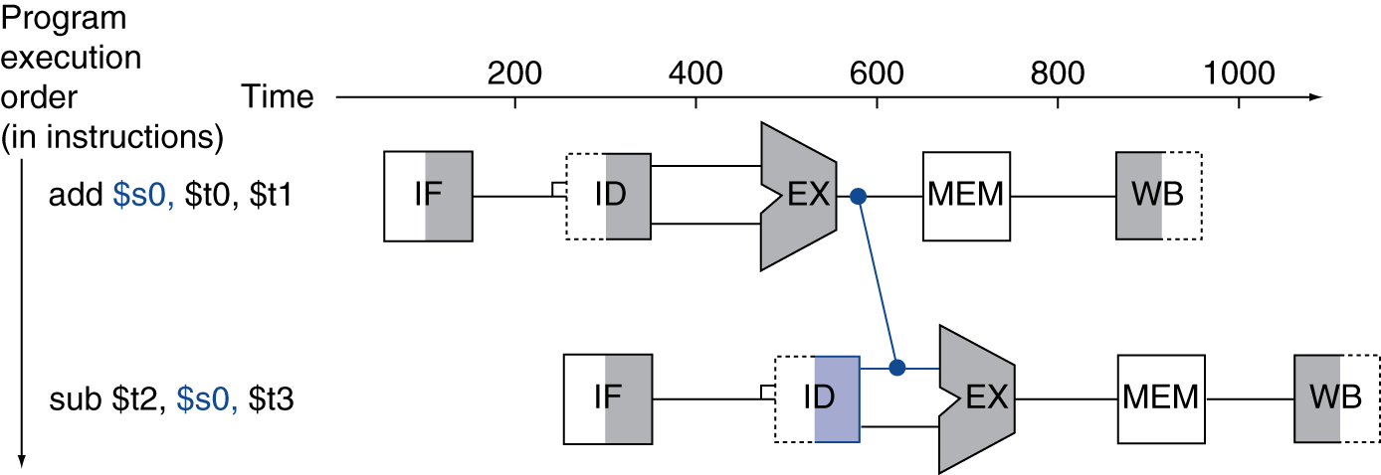
Forwarding (aka Bypassing)
Use result when it is computed
Don’t wait for it to be stored in a register
Requires extra connections in the datapath

Slide 42
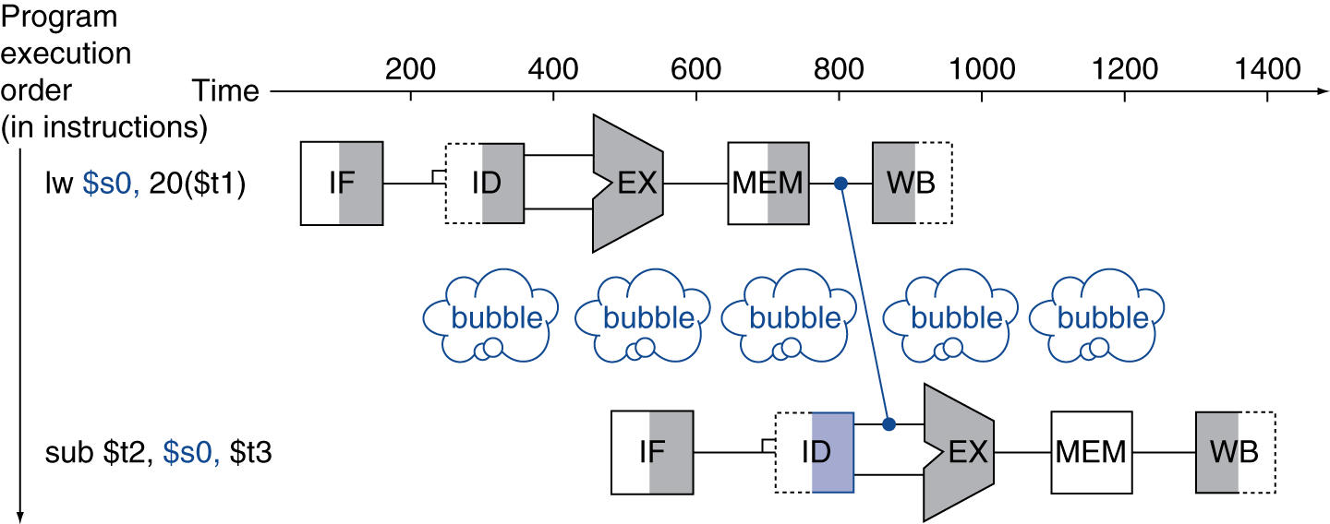
Load-Use Data Hazard
Can’t always avoid stalls by forwarding
If value not computed when needed
Can’t forward backward in time!

Slide 43
Code Scheduling to Avoid Stalls
Reorder code to avoid use of load result in the next instruction
C code for A = B + E; C = B + F;
A(12), B(0), E(4), C(16), F(8)
lw $t1, 0($t0)
lw $t2, 4($t0)
add $t3, $t1, $t2
sw $t3, 12($t0)
lw $t4, 8($t0)
add $t5, $t1, $t4
sw $t5, 16($t0)
lw $t1, 0($t0)
lw $t2, 4($t0)
lw $t4, 8($t0)
add $t3, $t1, $t2
sw $t3, 12($t0)
add $t5, $t1, $t4
sw $t5, 16($t0)
stall
stall
13 cycles
11 cycles

Slide 44
Control Hazards
Branch determines flow of control
Fetching next instruction depends on branch outcome
Pipeline can’t always fetch correct instruction
Still working on ID stage of branch
In MIPS pipeline
Need to compare registers and compute target early in the pipeline
Add hardware to do it in ID stage

Slide 45
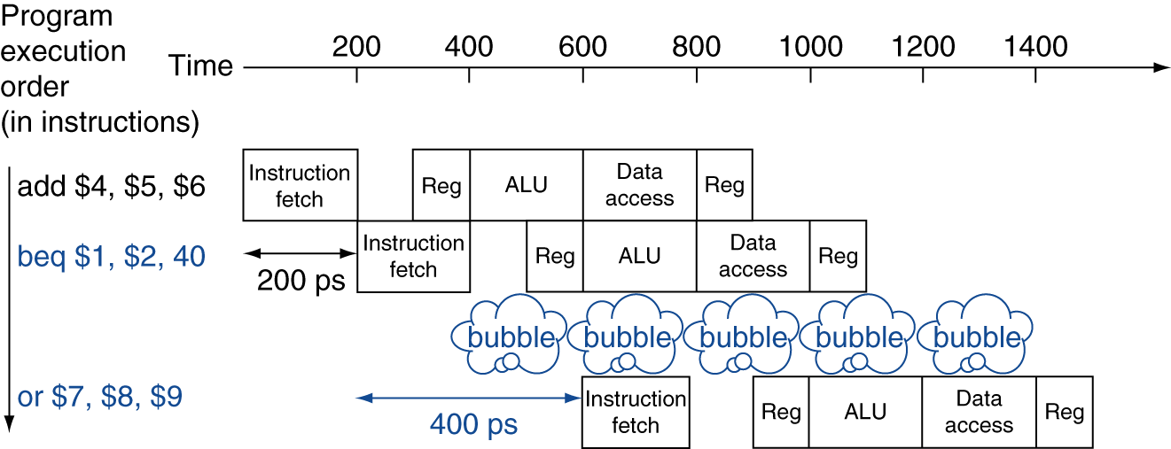
Stall on Branch
Wait until branch outcome determined before fetching next instruction

Slide 46
Branch Prediction
Longer pipelines can’t readily determine branch outcome early
Stall penalty becomes unacceptable
Predict outcome of branch
Only stall if prediction is wrong
In MIPS pipeline
Can predict branches not taken
Fetch instruction after branch, with no delay

Slide 47
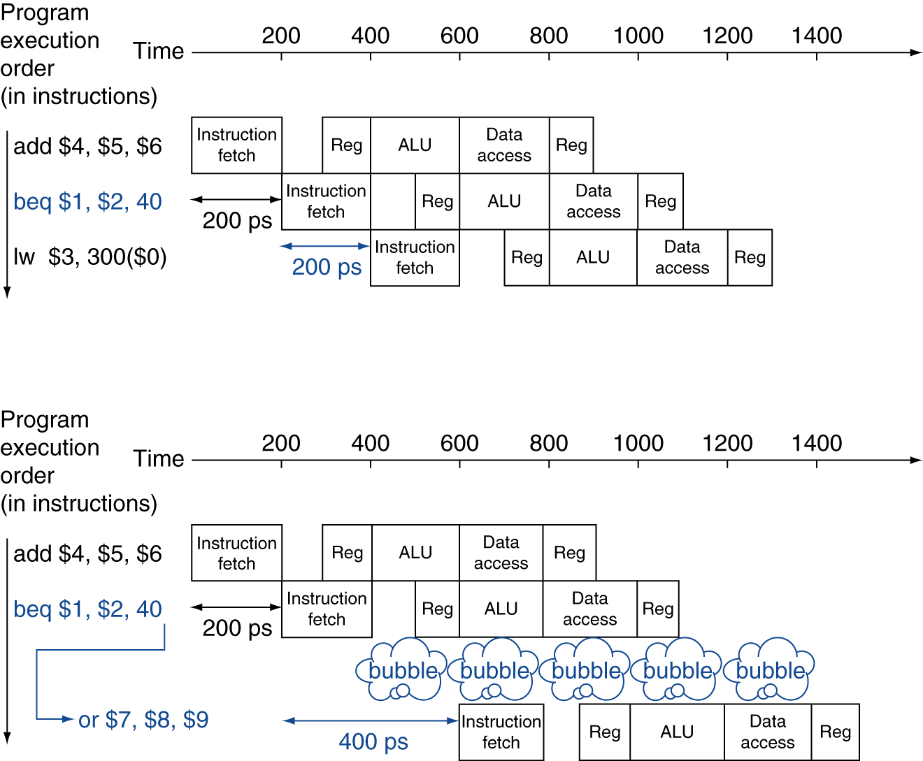
MIPS with Predict Not Taken
Prediction correct
Prediction incorrect

Slide 48
More-Realistic Branch Prediction
Static branch prediction
Based on typical branch behavior
Example: loop and if-statement branches
Predict backward branches taken
Predict forward branches not taken
Dynamic branch prediction
Hardware measures actual branch behavior
e.g., record recent history of each branch
Assume future behavior will continue the trend
When wrong, stall while re-fetching, and update history

Slide 49
Pipeline Summary
The BIG Picture
Pipelining improves performance by increasing instruction throughput
Executes multiple instructions in parallel
Each instruction has the same latency
Subject to hazards
Structure, data, control
Instruction set design affects complexity of pipeline implementation

Slide 50
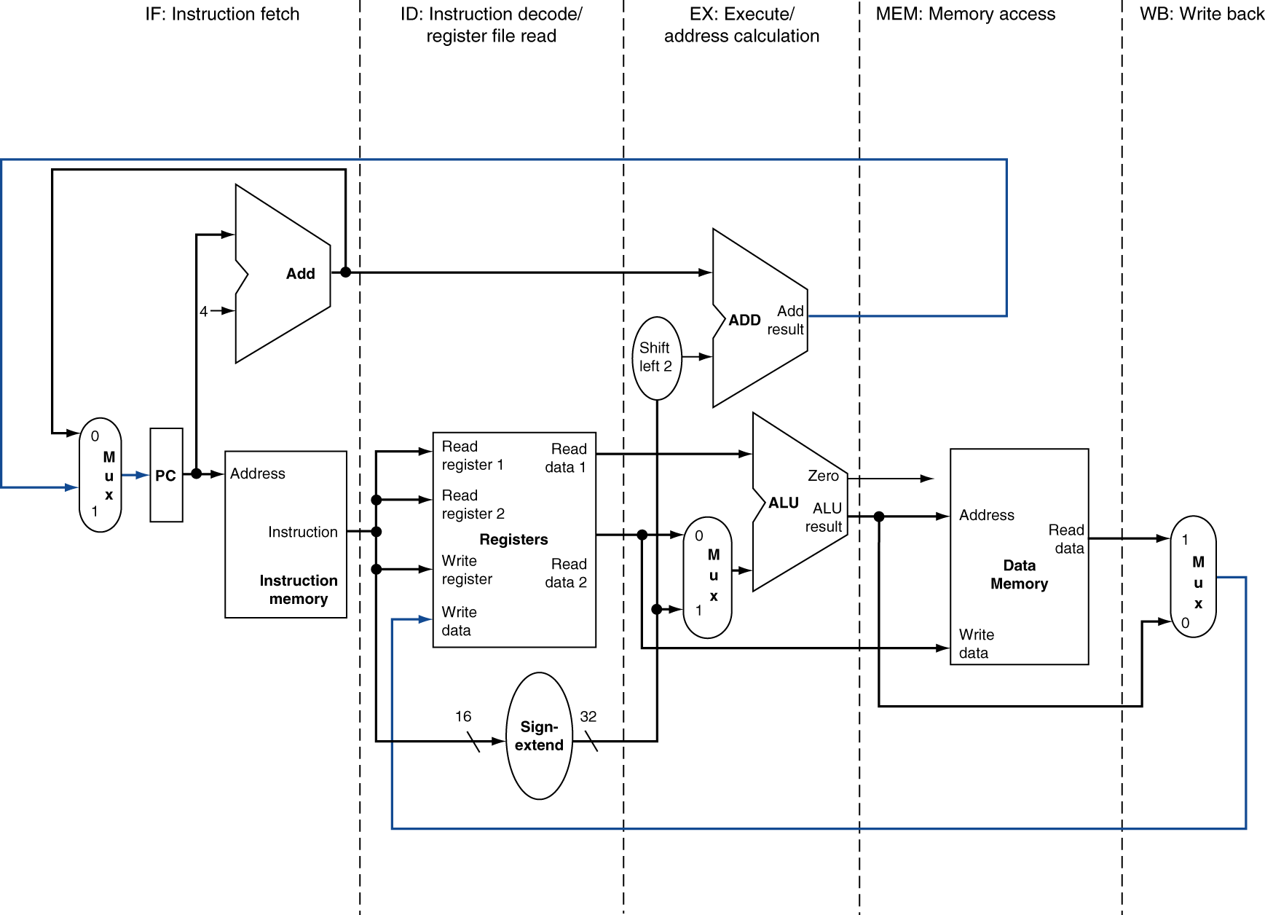
MIPS Pipelined Datapath
§4.6 Pipelined Datapath and Control
MEM
Right-to-left flow leads to hazards
WB

Slide 51
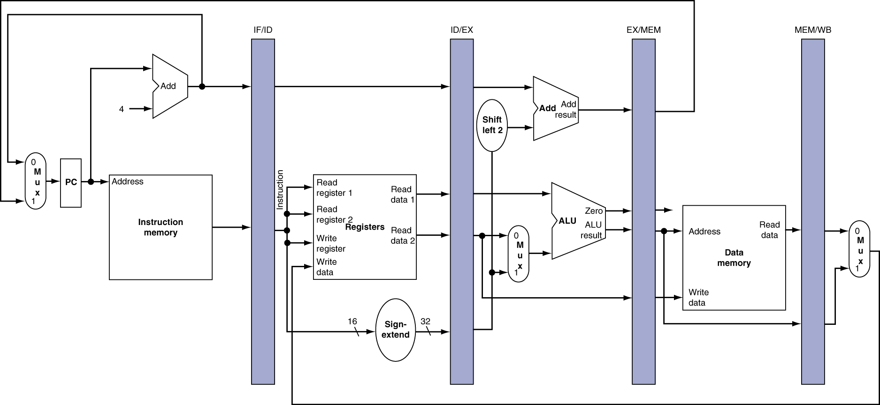
Pipeline registers
Need registers between stages
To hold information produced in previous cycle

Slide 52
Pipeline Operation
Cycle-by-cycle flow of instructions through the pipelined datapath
“Single-clock-cycle” pipeline diagram
Shows pipeline usage in a single cycle
Highlight resources used
c.f. “multi-clock-cycle” diagram
Graph of operation over time
We’ll look at “single-clock-cycle” diagrams for load & store

Slide 53
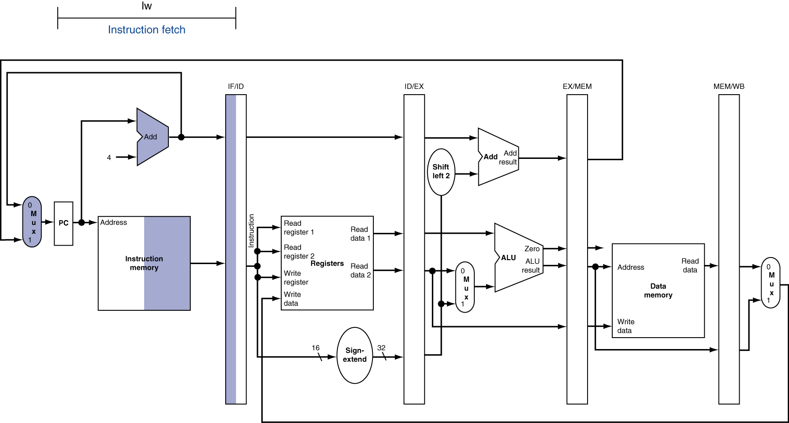
IF for Load, Store, …

Slide 54
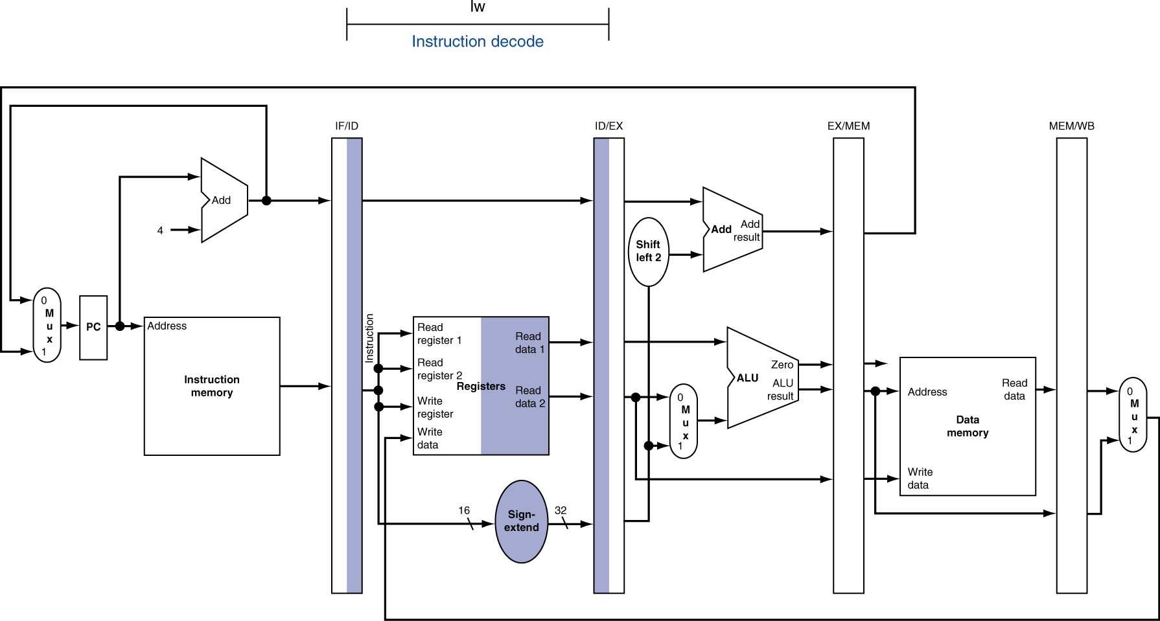
ID for Load, Store, …

Slide 55
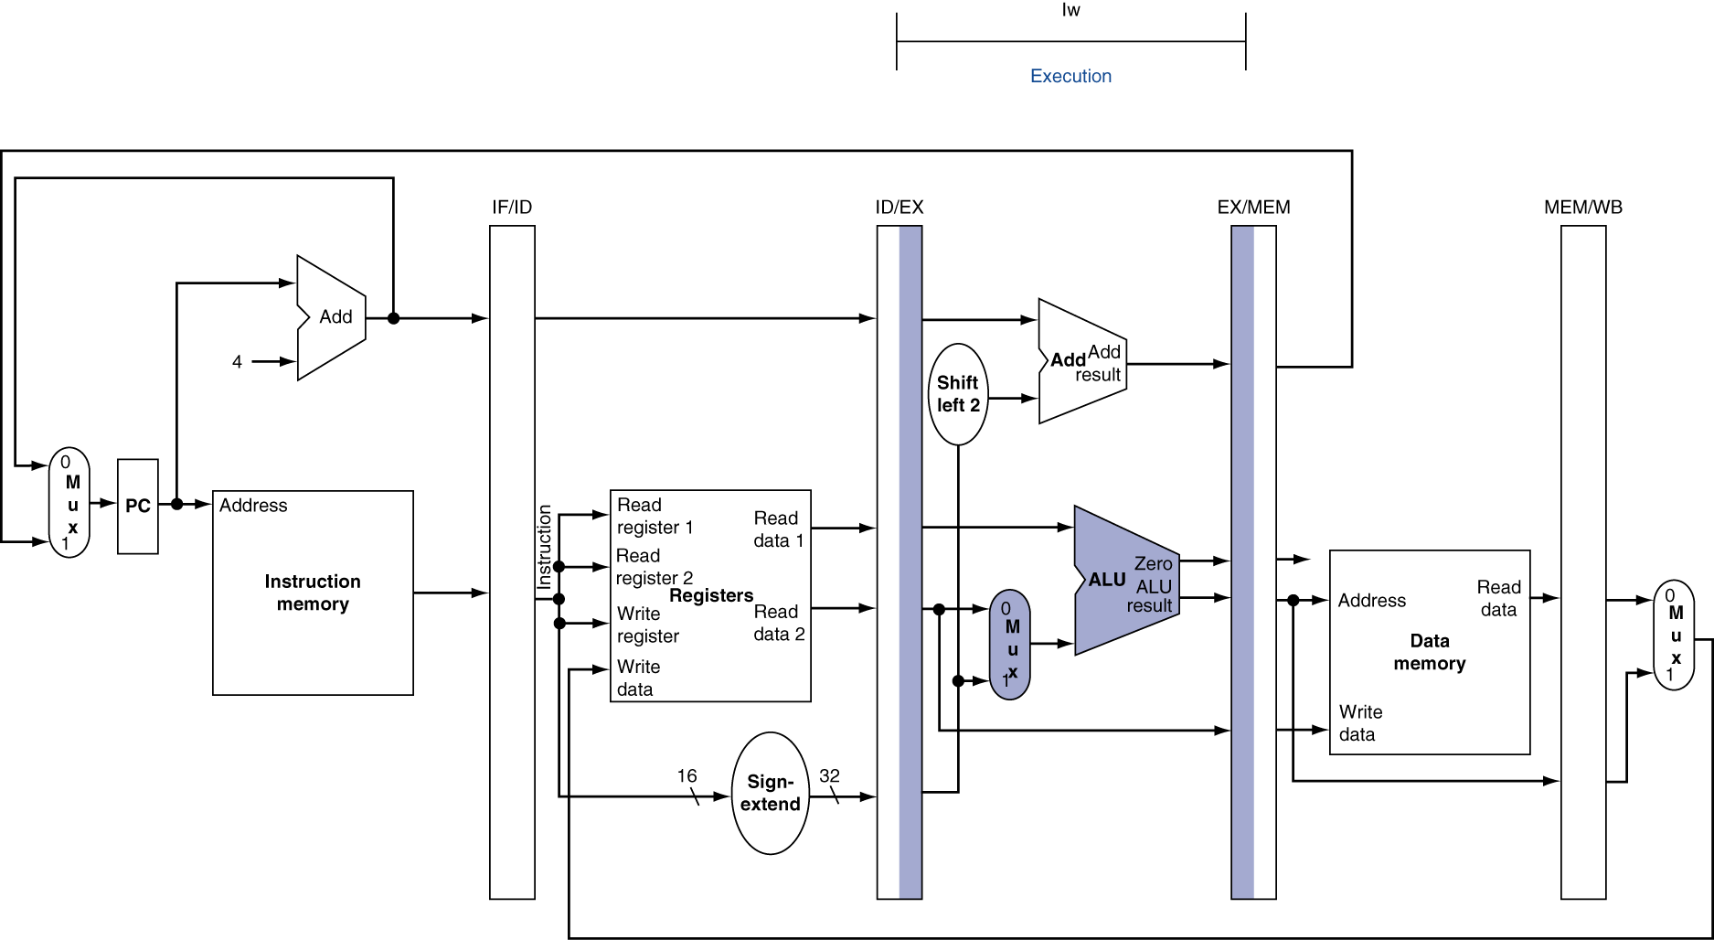
EX for Load

Slide 56
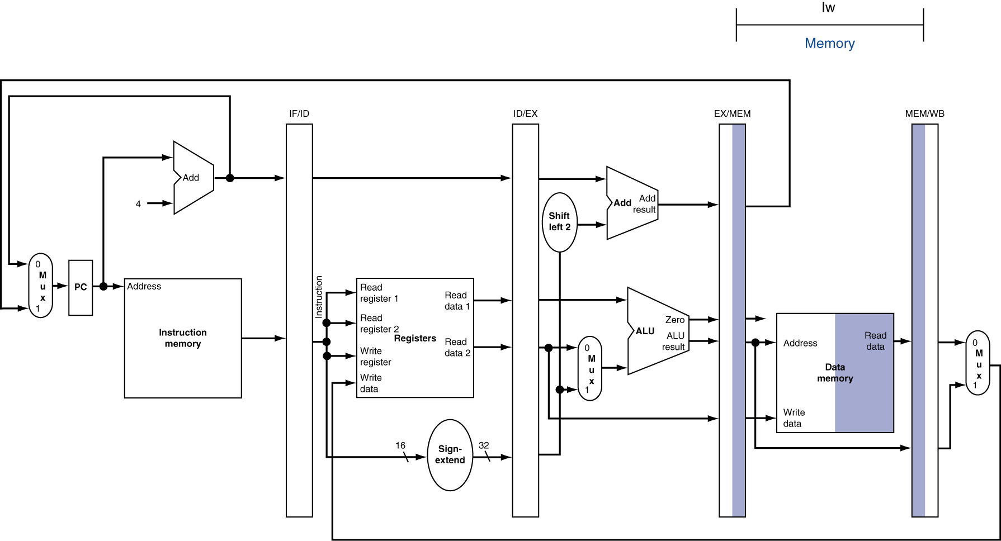
MEM for Load

Slide 57
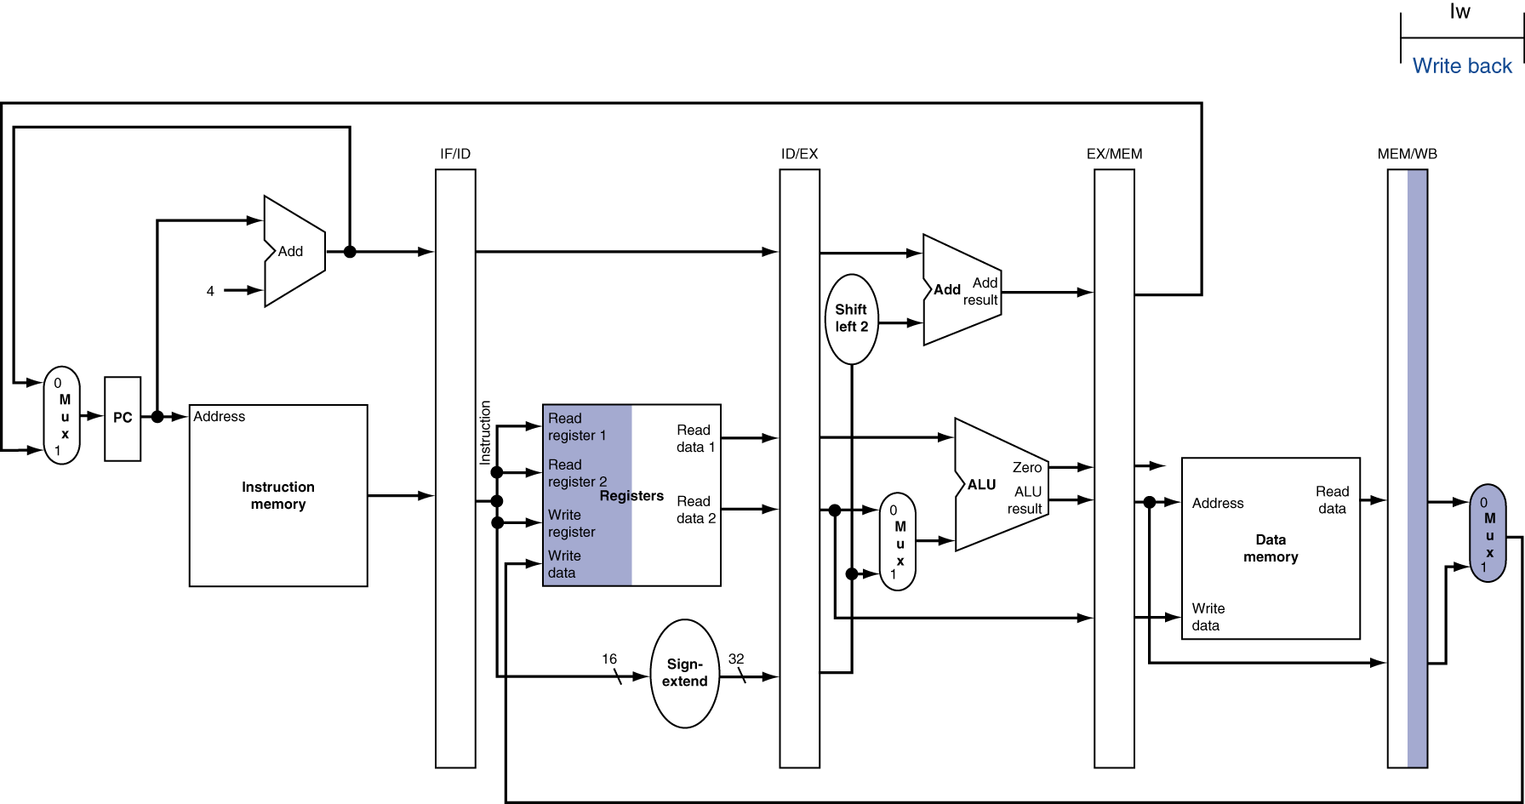
WB for Load
Wrong register number

Slide 58
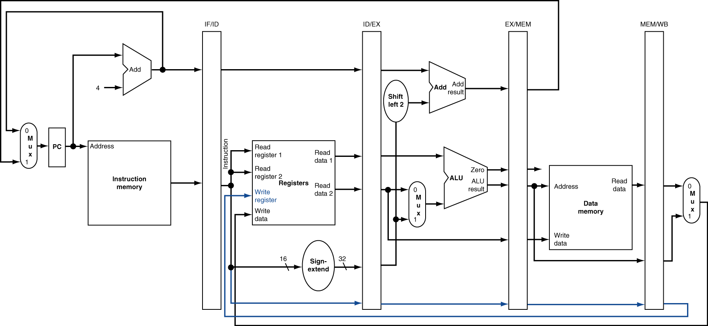
Corrected Datapath for Load

Slide 59
EX for Store

Slide 60
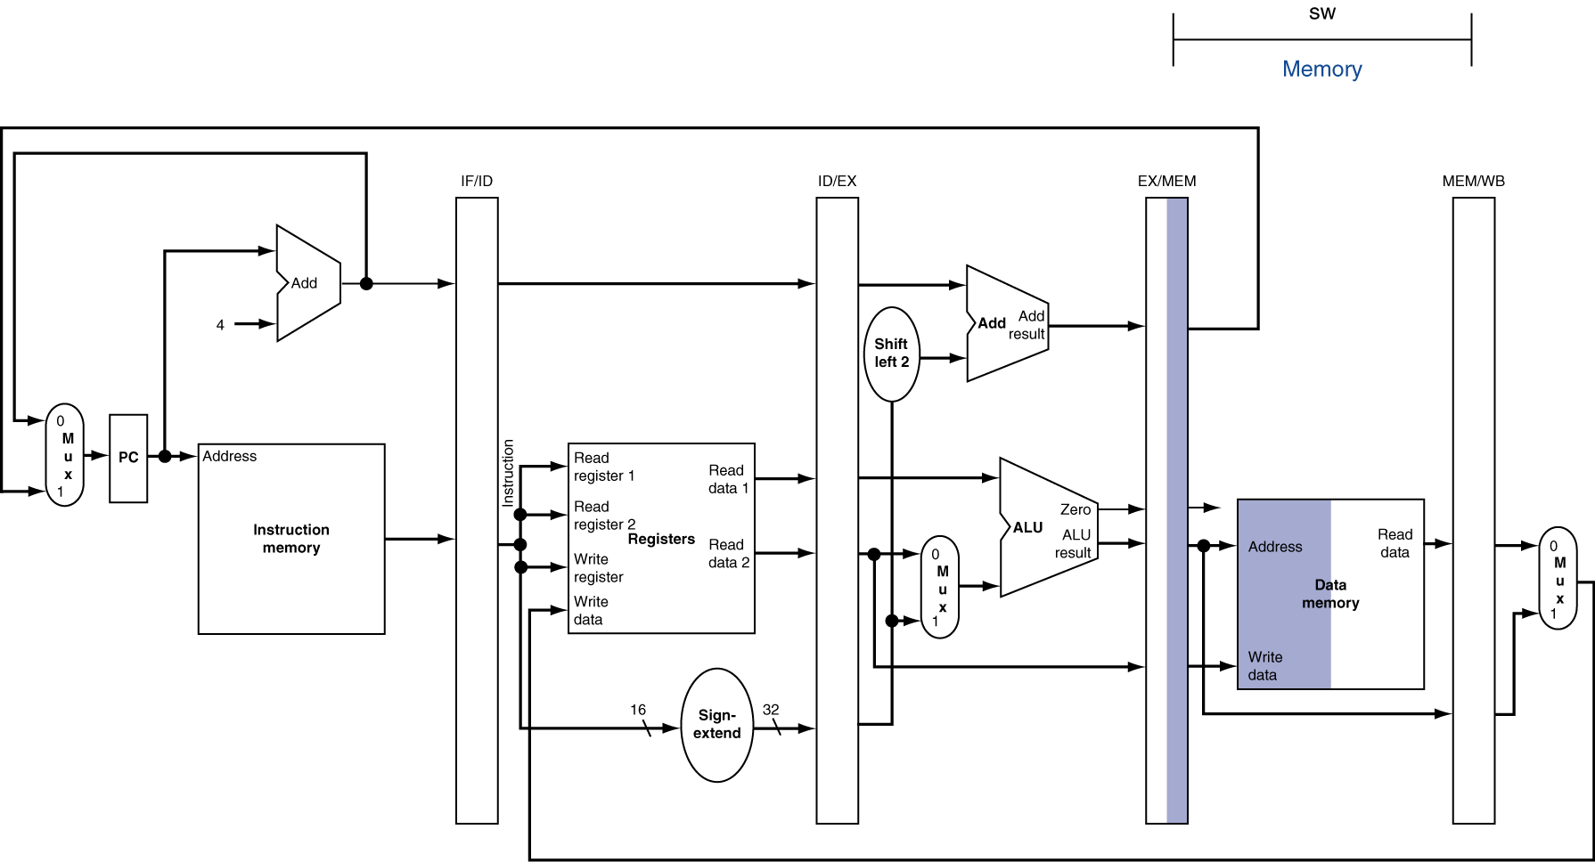
MEM for Store

Slide 61
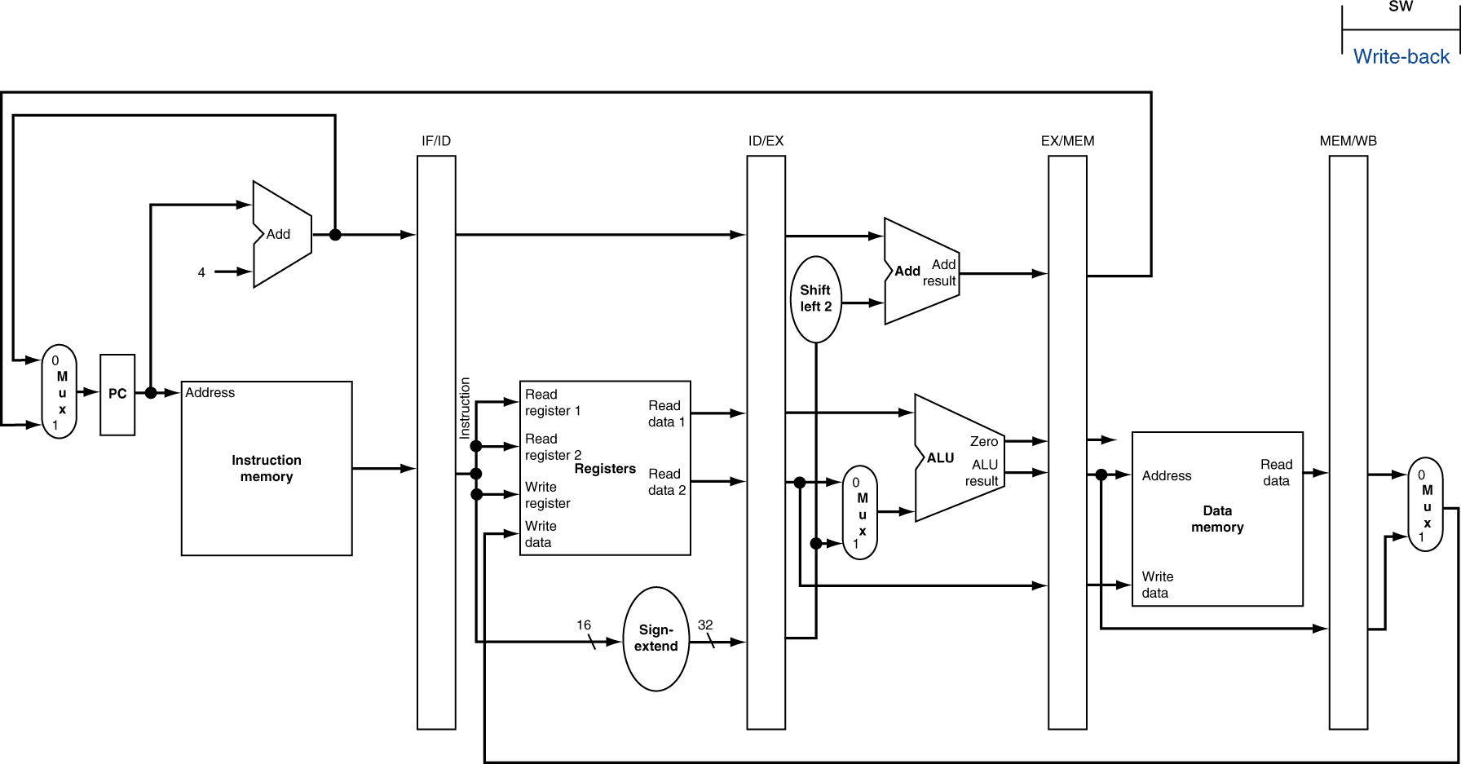
WB for Store

Slide 62
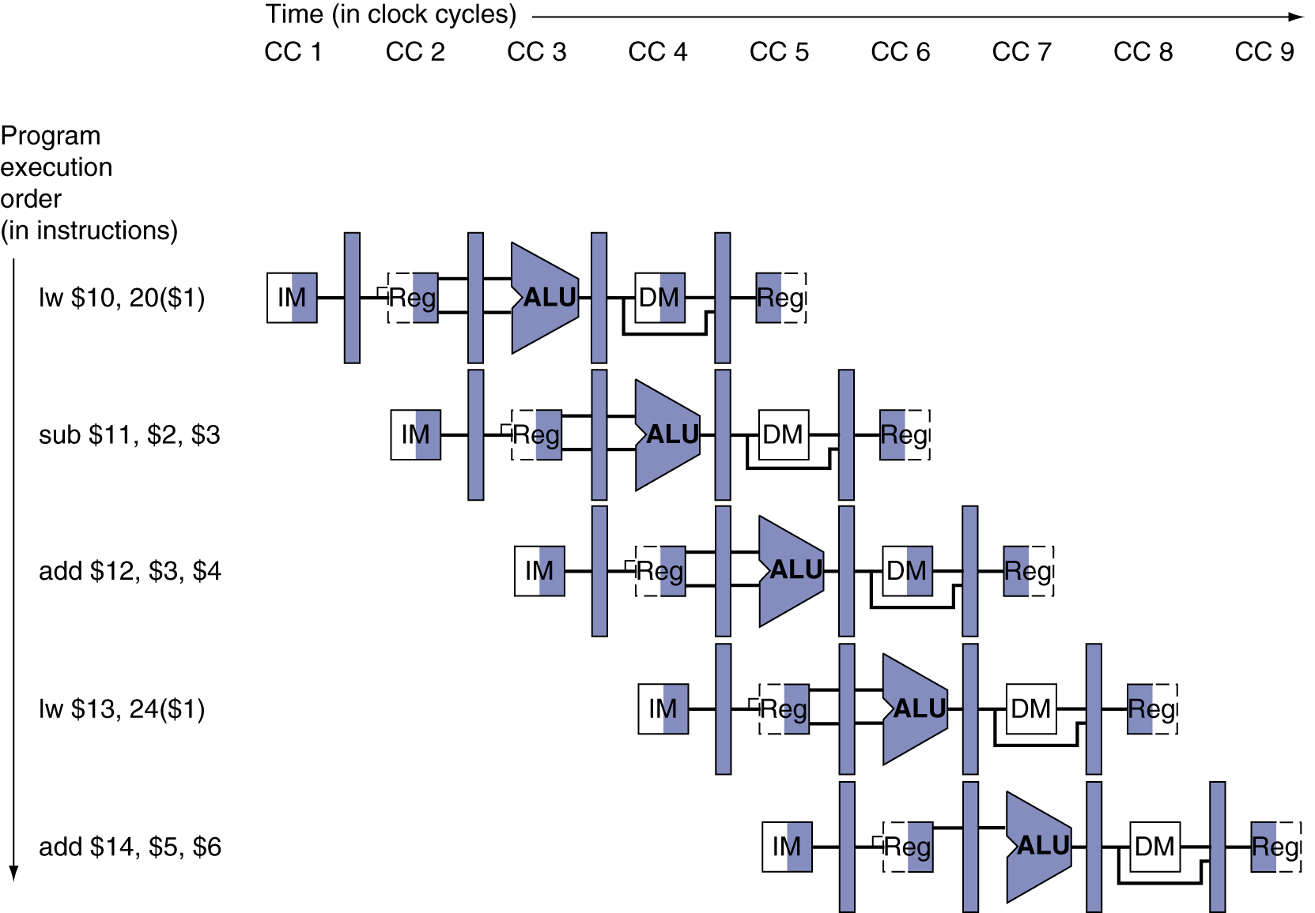
Multi-Cycle Pipeline Diagram
Form showing resource usage

Slide 63
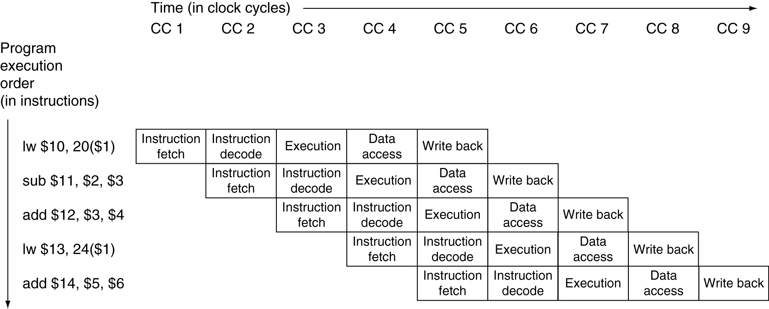
Multi-Cycle Pipeline Diagram
Traditional form

Slide 64
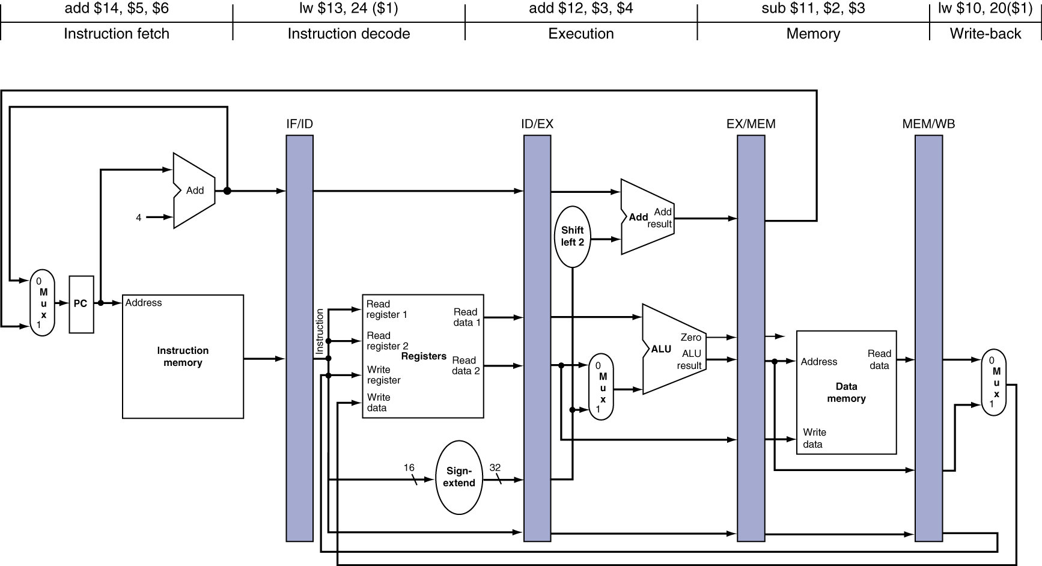
Single-Cycle Pipeline Diagram
State of pipeline in a given cycle

Slide 65
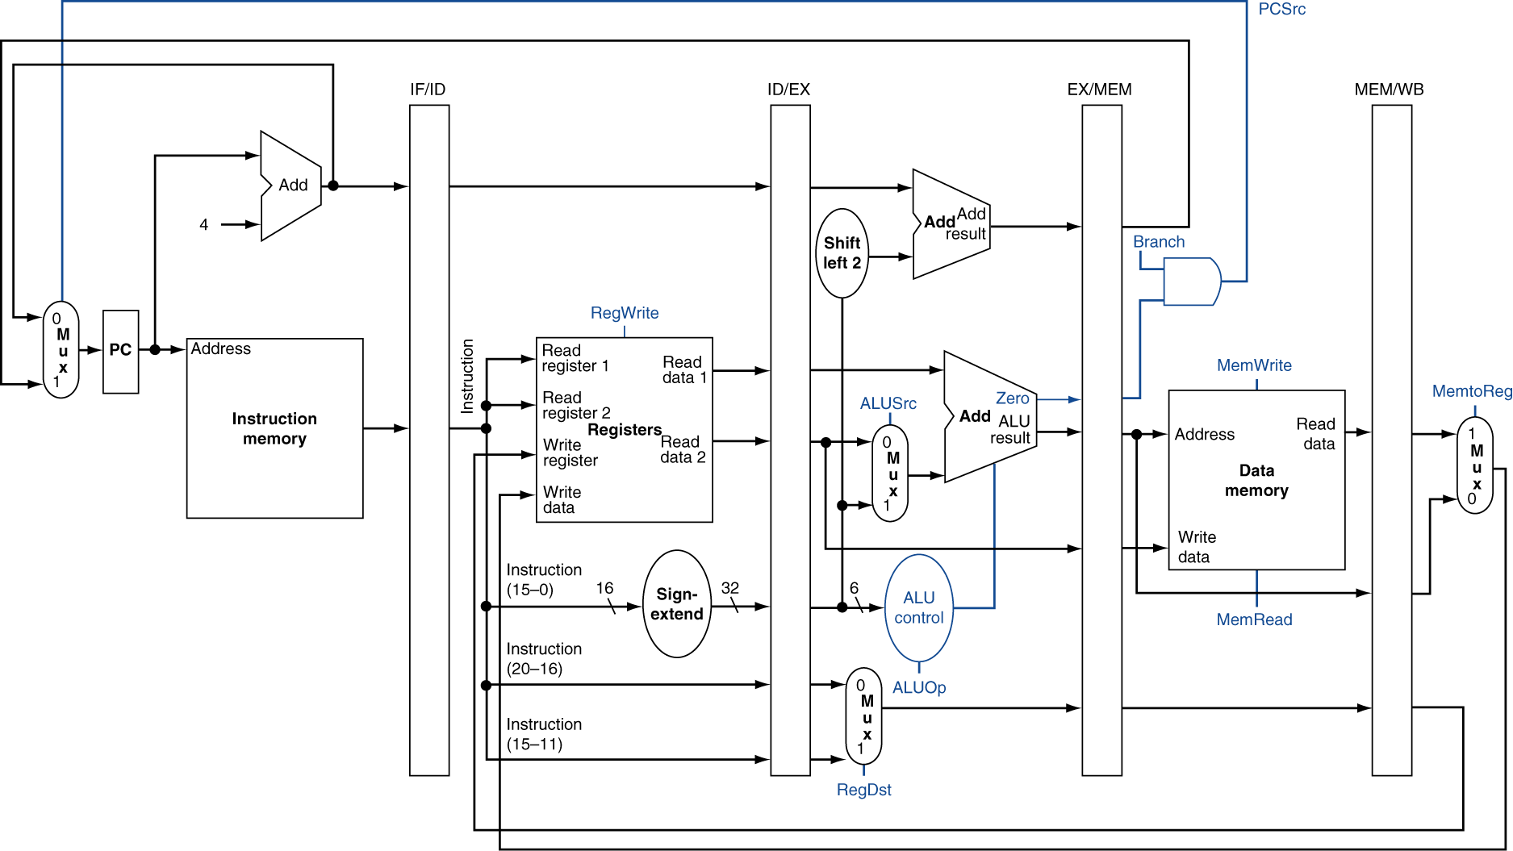
Pipelined Control (Simplified)

Slide 66
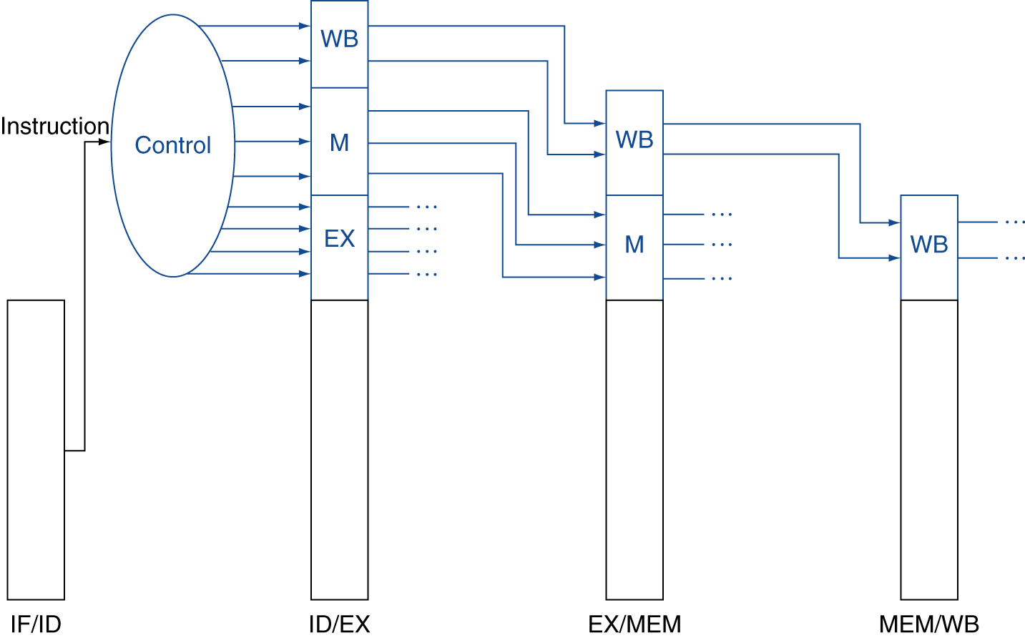
Pipelined Control
Control signals derived from instruction
As in single-cycle implementation

Slide 67
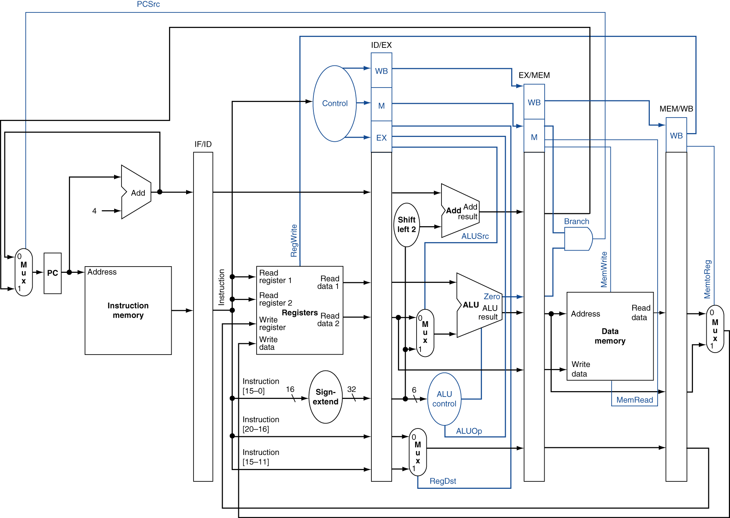
Pipelined Control

Slide 68
Data Hazards in ALU Instructions
Consider this sequence:
sub $2, $1,$3 and $12,$2,$5 or $13,$6,$2 add $14,$2,$2 sw $15,100($2)
We can resolve hazards with forwarding
How do we detect when to forward?
§4.7 Data Hazards: Forwarding vs. Stalling

Slide 69
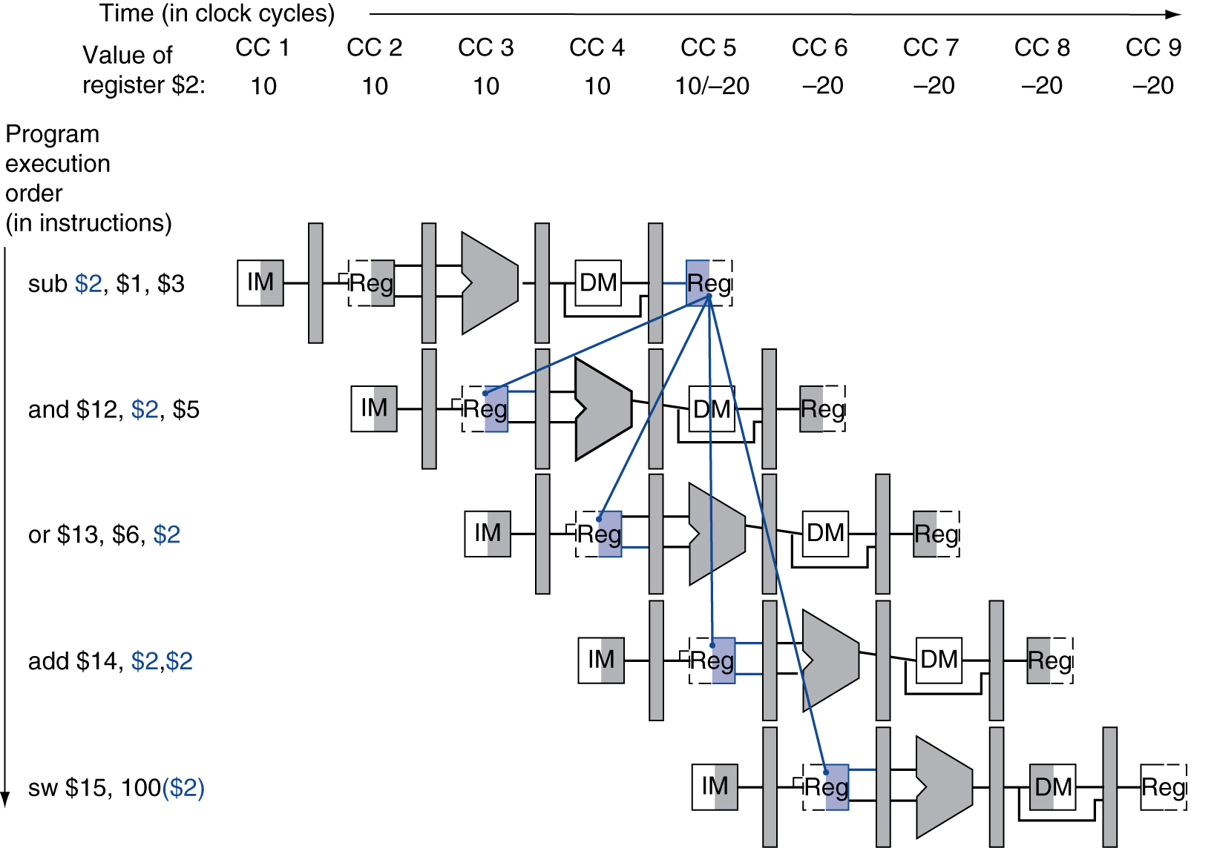
Dependencies & Forwarding

Slide 70
Detecting the Need to Forward
Pass register numbers along pipeline
e.g., ID/EX.RegisterRs = register number for Rs sitting in ID/EX pipeline register
ALU operand register numbers in EX stage are given by
ID/EX.RegisterRs, ID/EX.RegisterRt
Data hazards when
1a. EX/MEM.RegisterRd = ID/EX.RegisterRs
1b. EX/MEM.RegisterRd = ID/EX.RegisterRt
2a. MEM/WB.RegisterRd = ID/EX.RegisterRs
2b. MEM/WB.RegisterRd = ID/EX.RegisterRt
Fwd from EX/MEM pipeline reg
Fwd from MEM/WB pipeline reg

Slide 71
Detecting the Need to Forward
But only if forwarding instruction will write to a register!
EX/MEM.RegWrite, MEM/WB.RegWrite
And only if Rd for that instruction is not $zero
EX/MEM.RegisterRd ≠ 0, MEM/WB.RegisterRd ≠ 0

Slide 72
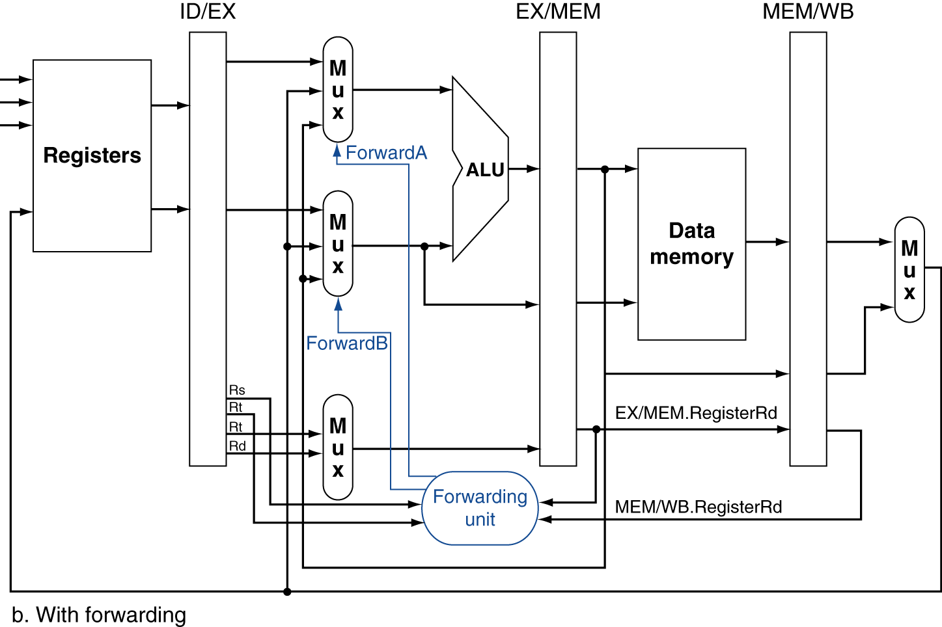
Forwarding Paths

Slide 73
Forwarding Conditions
EX hazard
if (EX/MEM.RegWrite and (EX/MEM.RegisterRd ≠ 0) and (EX/MEM.RegisterRd = ID/EX.RegisterRs)) ForwardA = 10
if (EX/MEM.RegWrite and (EX/MEM.RegisterRd ≠ 0) and (EX/MEM.RegisterRd = ID/EX.RegisterRt)) ForwardB = 10
MEM hazard
if (MEM/WB.RegWrite and (MEM/WB.RegisterRd ≠ 0) and (MEM/WB.RegisterRd = ID/EX.RegisterRs)) ForwardA = 01
if (MEM/WB.RegWrite and (MEM/WB.RegisterRd ≠ 0) and (MEM/WB.RegisterRd = ID/EX.RegisterRt)) ForwardB = 01

Slide 74
Double Data Hazard
Consider the sequence:
add $1,$1,$2 add $1,$1,$3 add $1,$1,$4
Both hazards occur
Want to use the most recent
Revise MEM hazard condition
Only fwd if EX hazard condition isn’t true

Slide 75
Revised Forwarding Condition
MEM hazard
if (MEM/WB.RegWrite and (MEM/WB.RegisterRd ≠ 0) and not (EX/MEM.RegWrite and (EX/MEM.RegisterRd ≠ 0) and (EX/MEM.RegisterRd = ID/EX.RegisterRs)) and (MEM/WB.RegisterRd = ID/EX.RegisterRs)) ForwardA = 01
if (MEM/WB.RegWrite and (MEM/WB.RegisterRd ≠ 0) and not (EX/MEM.RegWrite and (EX/MEM.RegisterRd ≠ 0) and (EX/MEM.RegisterRd = ID/EX.RegisterRt)) and (MEM/WB.RegisterRd = ID/EX.RegisterRt)) ForwardB = 01

Slide 76
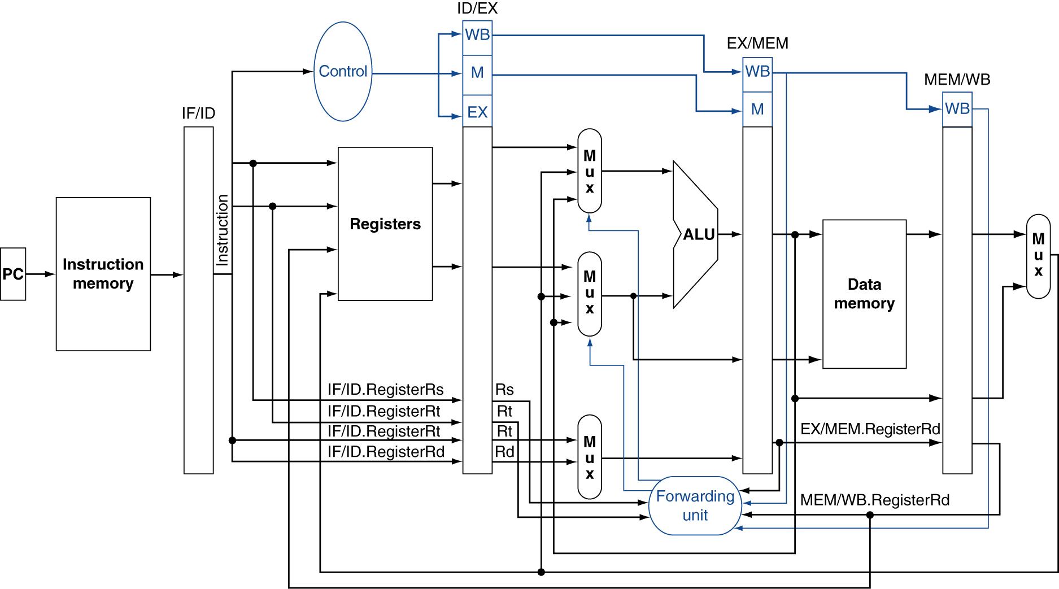
Datapath with Forwarding

Slide 77
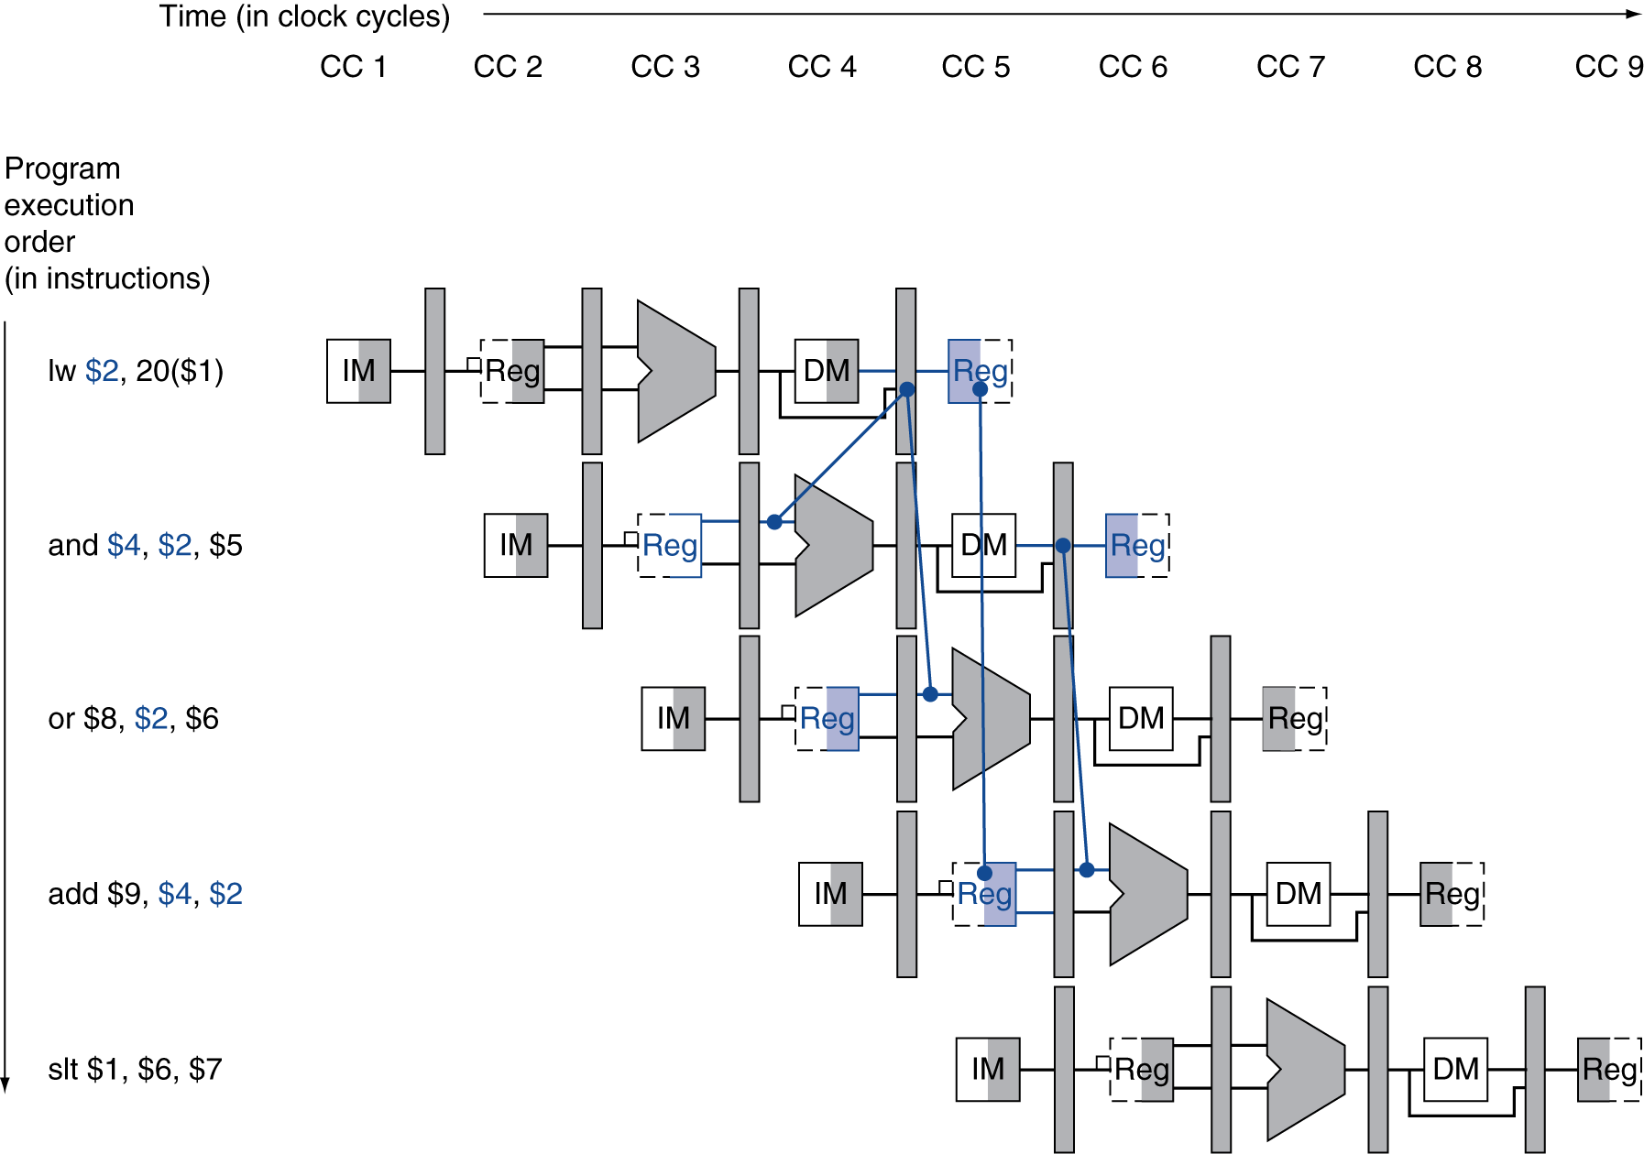
Load-Use Data Hazard
Need to stall for one cycle

Slide 78
Load-Use Hazard Detection
Check when using instruction is decoded in ID stage
ALU operand register numbers in ID stage are given by
IF/ID.RegisterRs, IF/ID.RegisterRt
Load-use hazard when
ID/EX.MemRead and ((ID/EX.RegisterRt = IF/ID.RegisterRs) or (ID/EX.RegisterRt = IF/ID.RegisterRt))
If detected, stall and insert bubble

Slide 79
How to Stall the Pipeline
Force control values in ID/EX register to 0
EX, MEM and WB do nop (no-operation)
Prevent update of PC and IF/ID register
Using instruction is decoded again
Following instruction is fetched again
1-cycle stall allows MEM to read data for lw
Can subsequently forward to EX stage

Slide 80
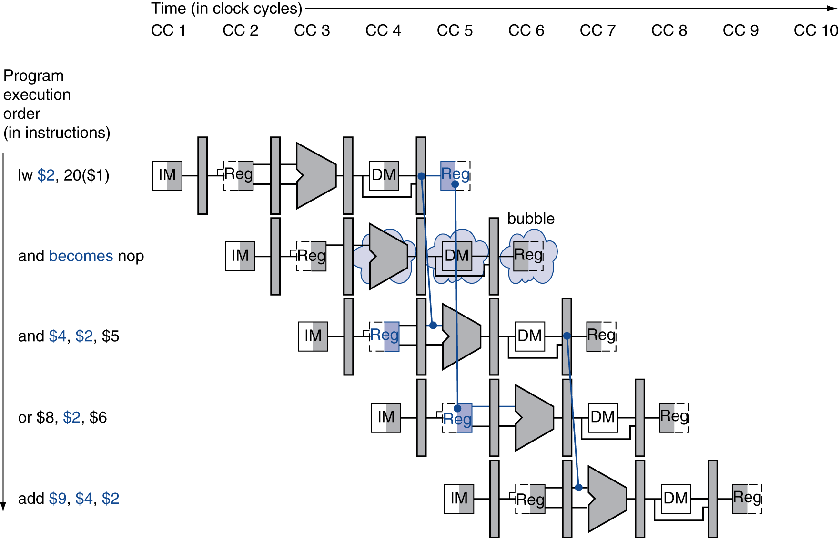
Stall/Bubble in the Pipeline
Stall inserted here

Slide 81
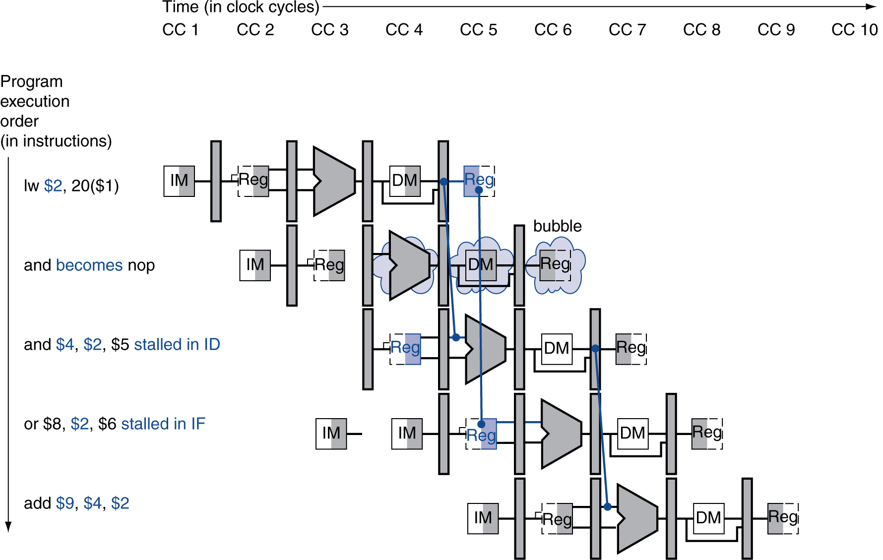
Stall/Bubble in the Pipeline
Or, more accurately…

Slide 82
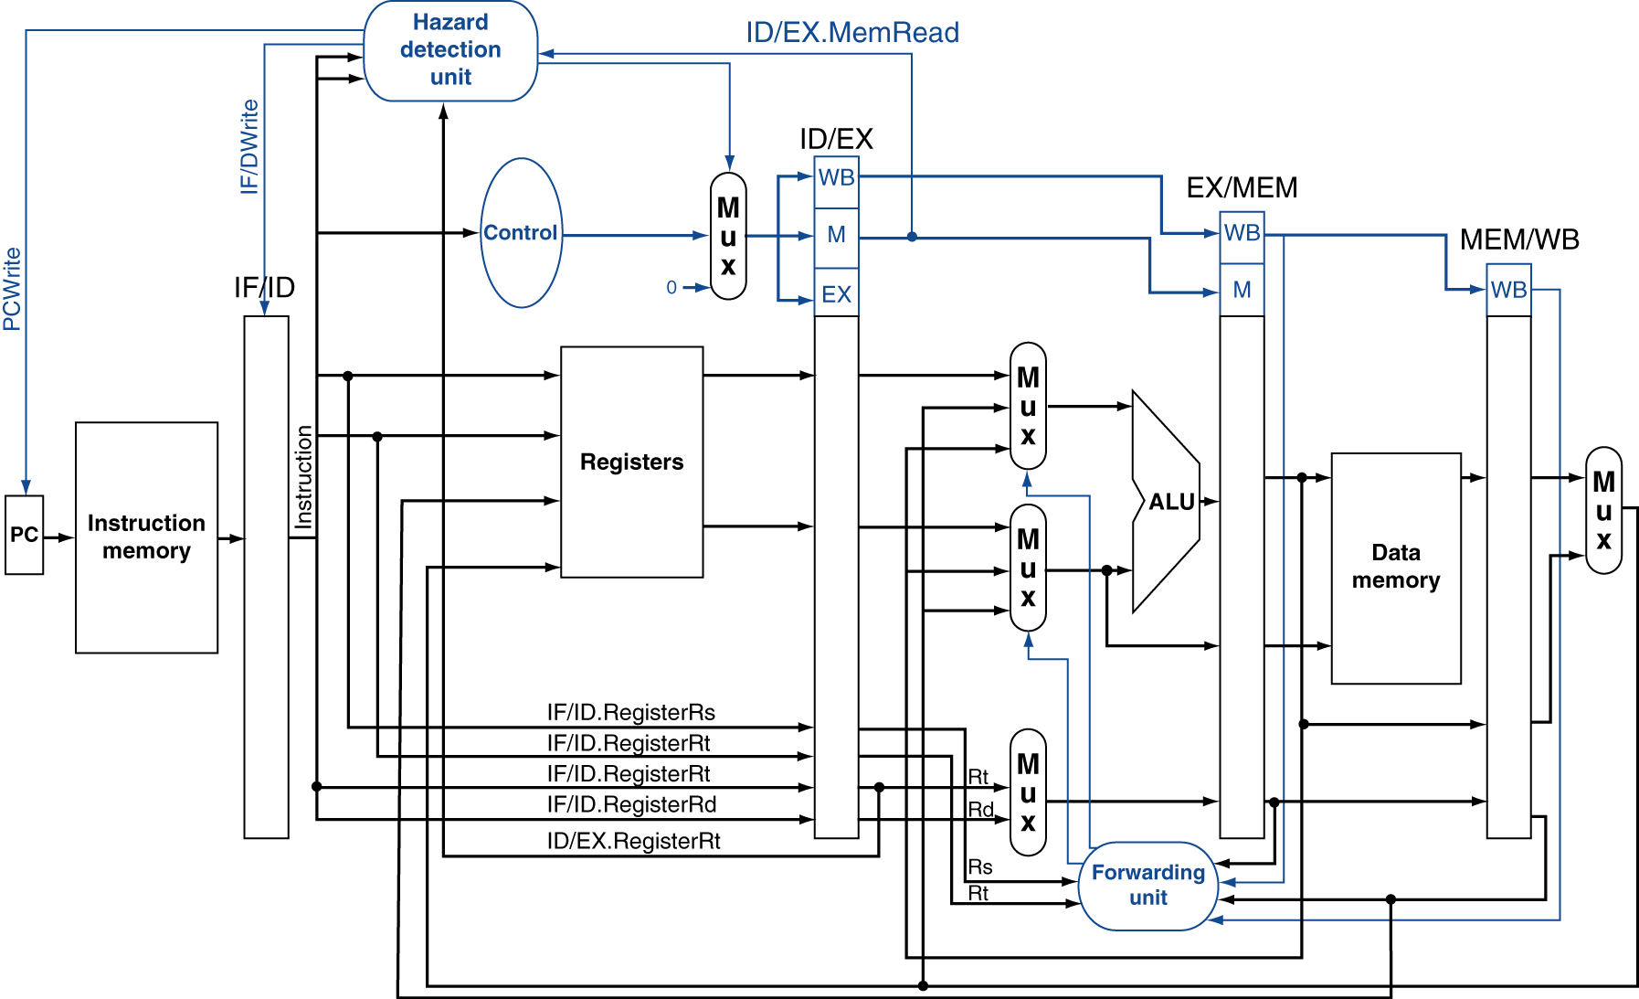
Datapath with Hazard Detection

Slide 83
Stalls and Performance
The BIG Picture
Stalls reduce performance
But are required to get correct results
Compiler can arrange code to avoid hazards and stalls
Requires knowledge of the pipeline structure

Slide 84
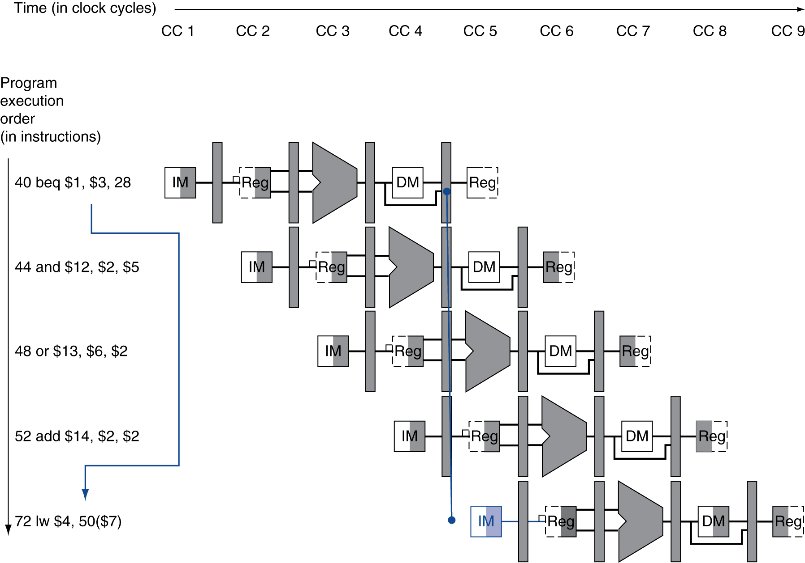
Branch Hazards
§4.8 Control Hazards
If branch outcome determined in MEM
Flush these instructions
(Set control values to 0)
PC

Slide 85
Reducing Branch Delay
Move hardware to determine outcome to ID stage
Target address adder
Register comparator
Example: branch taken
36: sub $10, $4, $8 40: beq $1, $3, 7 44: and $12, $2, $5 48: or $13, $2, $6 52: add $14, $4, $2 56: slt $15, $6, $7 ... 72: lw $4, 50($7)

Slide 86
Data Hazards for Branches
If a comparison register is a destination of 2nd or 3rd preceding ALU instruction
add $1, $2, $3
IF
ID
EX
MEM
WB
add $4, $5, $6
IF
ID
EX
MEM
WB
…
IF
ID
EX
MEM
WB
beq $1, $4, target
IF
ID
EX
MEM
WB
Can resolve using forwarding

Slide 87
Data Hazards for Branches
If a comparison register is a destination of preceding ALU instruction or 2nd preceding load instruction
Need 1 stall cycle
lw $1, addr
IF
ID
EX
MEM
WB
add $4, $5, $6
IF
ID
EX
MEM
WB
beq stalled
IF
ID
beq $1, $4, target
ID
EX
MEM
WB

Slide 88
Data Hazards for Branches
If a comparison register is a destination of immediately preceding load instruction
Need 2 stall cycles
lw $1, addr
IF
ID
EX
MEM
WB
beq stalled
IF
ID
beq stalled
ID
beq $1, $0, target
ID
EX
MEM
WB

Slide 89
Dynamic Branch Prediction
In deeper and superscalar pipelines, branch penalty is more significant
Use dynamic prediction
Branch prediction buffer (aka branch history table)
Indexed by recent branch instruction addresses
Stores outcome (taken/not taken)
To execute a branch
Check table, expect the same outcome
Start fetching from fall-through or target
If wrong, flush pipeline and flip prediction

Slide 90
1-Bit Predictor: Shortcoming
Inner loop branches mispredicted twice!
outer: … … inner: …
…
beq …, …, inner … beq …, …, outer
Mispredict as taken on last iteration of inner loop
Then mispredict as not taken on first iteration of inner loop next time around

Slide 91
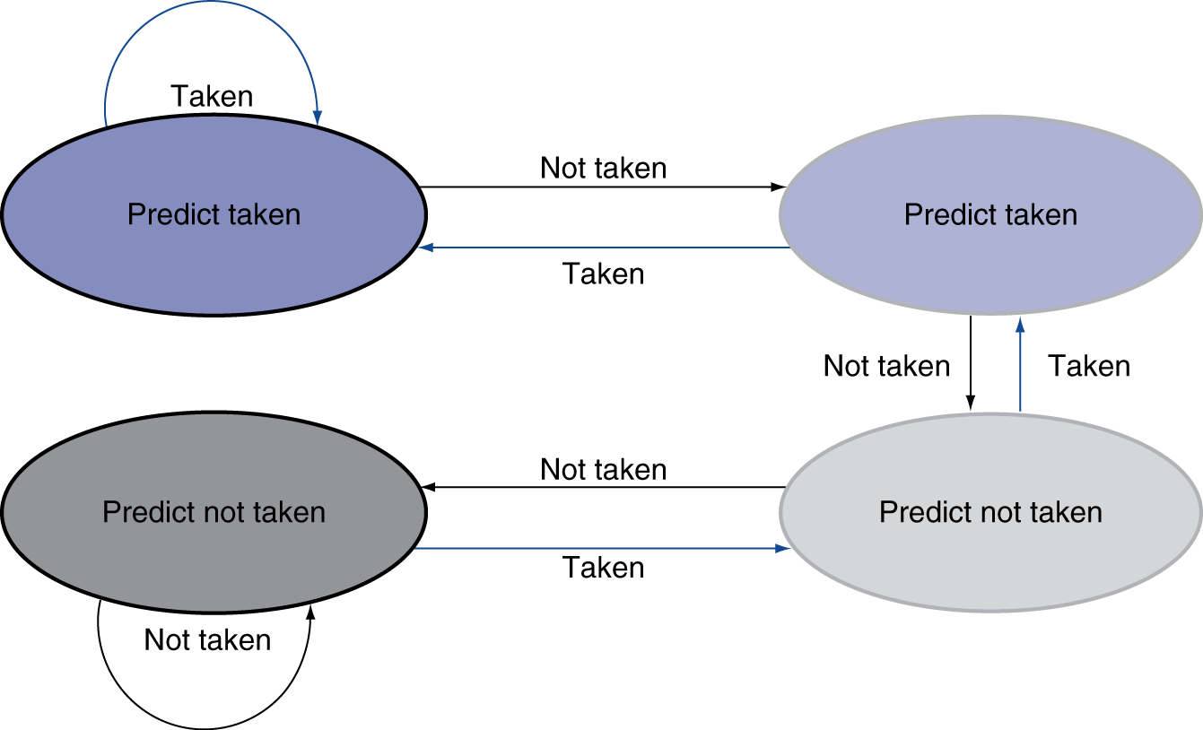
2-Bit Predictor
Only change prediction on two successive mispredictions

Slide 92
Calculating the Branch Target
Even with predictor, still need to calculate the target address
1-cycle penalty for a taken branch
Branch target buffer
Cache of target addresses
Indexed by PC when instruction fetched
If hit and instruction is branch predicted taken, can fetch target immediately

Slide 93
Fallacies
Pipelining is easy (!)
The basic idea is easy
The devil is in the details
e.g., detecting data hazards
Pipelining is independent of technology
So why haven’t we always done pipelining?
More transistors make more advanced techniques feasible
Pipeline-related ISA design needs to take account of technology trends
e.g., predicated instructions
§4.14 Fallacies and Pitfalls

Slide 94
Pitfalls
Poor ISA design can make pipelining harder
e.g., complex instruction sets (VAX, IA-32)
Significant overhead to make pipelining work
IA-32 micro-op approach
e.g., complex addressing modes
Register update side effects, memory indirection
e.g., delayed branches
Advanced pipelines have long delay slots

Slide 95
Concluding Remarks
ISA influences design of datapath and control
Datapath and control influence design of ISA
Pipelining improves instruction throughput using parallelism
More instructions completed per second
Latency for each instruction not reduced
Hazards: structural, data, control
§4.15 Concluding Remarks

